Slide 1

Surgical Technique
2.9 Labral Anchor

Slide 2
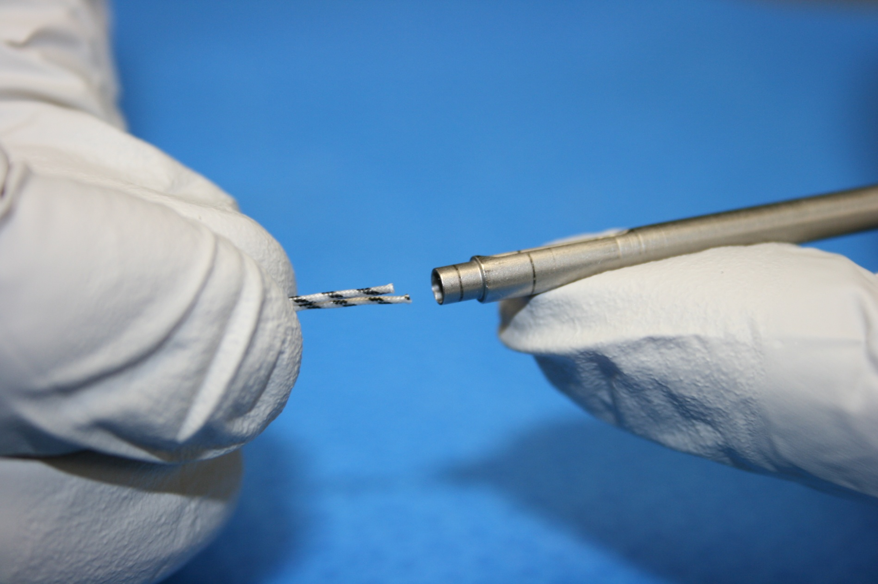
Loading the 2.9mm Anchor Inserter
2.9mm Labral Anchor
STEP 1

Slide 3
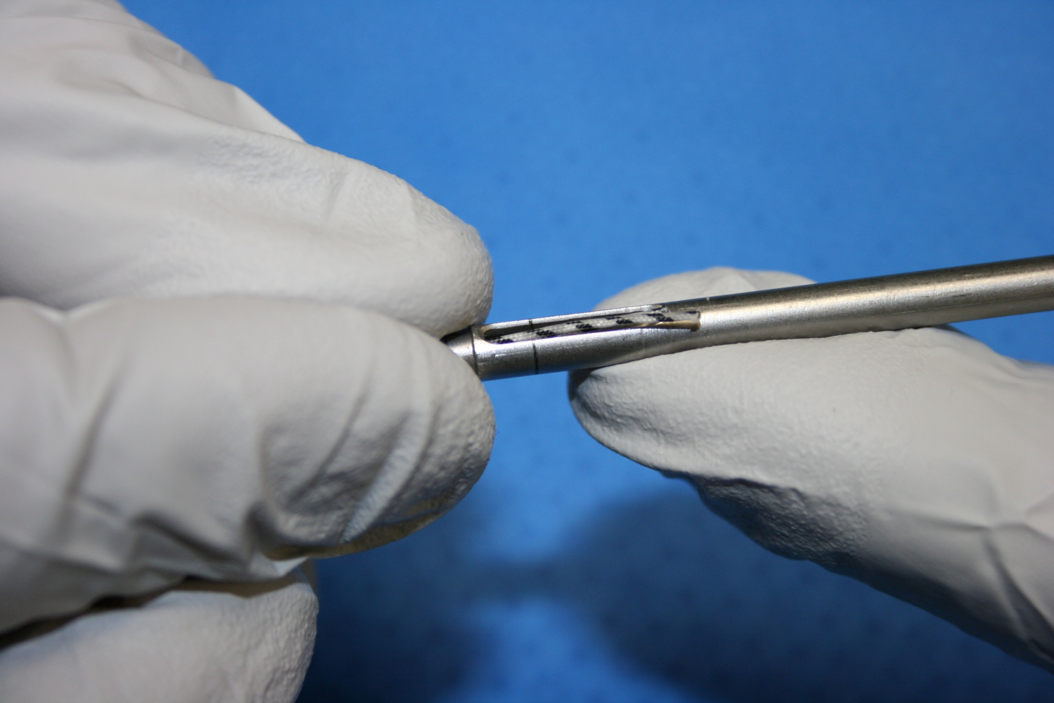
Loading the 2.9mm Anchor Inserter
2.9mm Labral Anchor
STEP 2

Slide 4
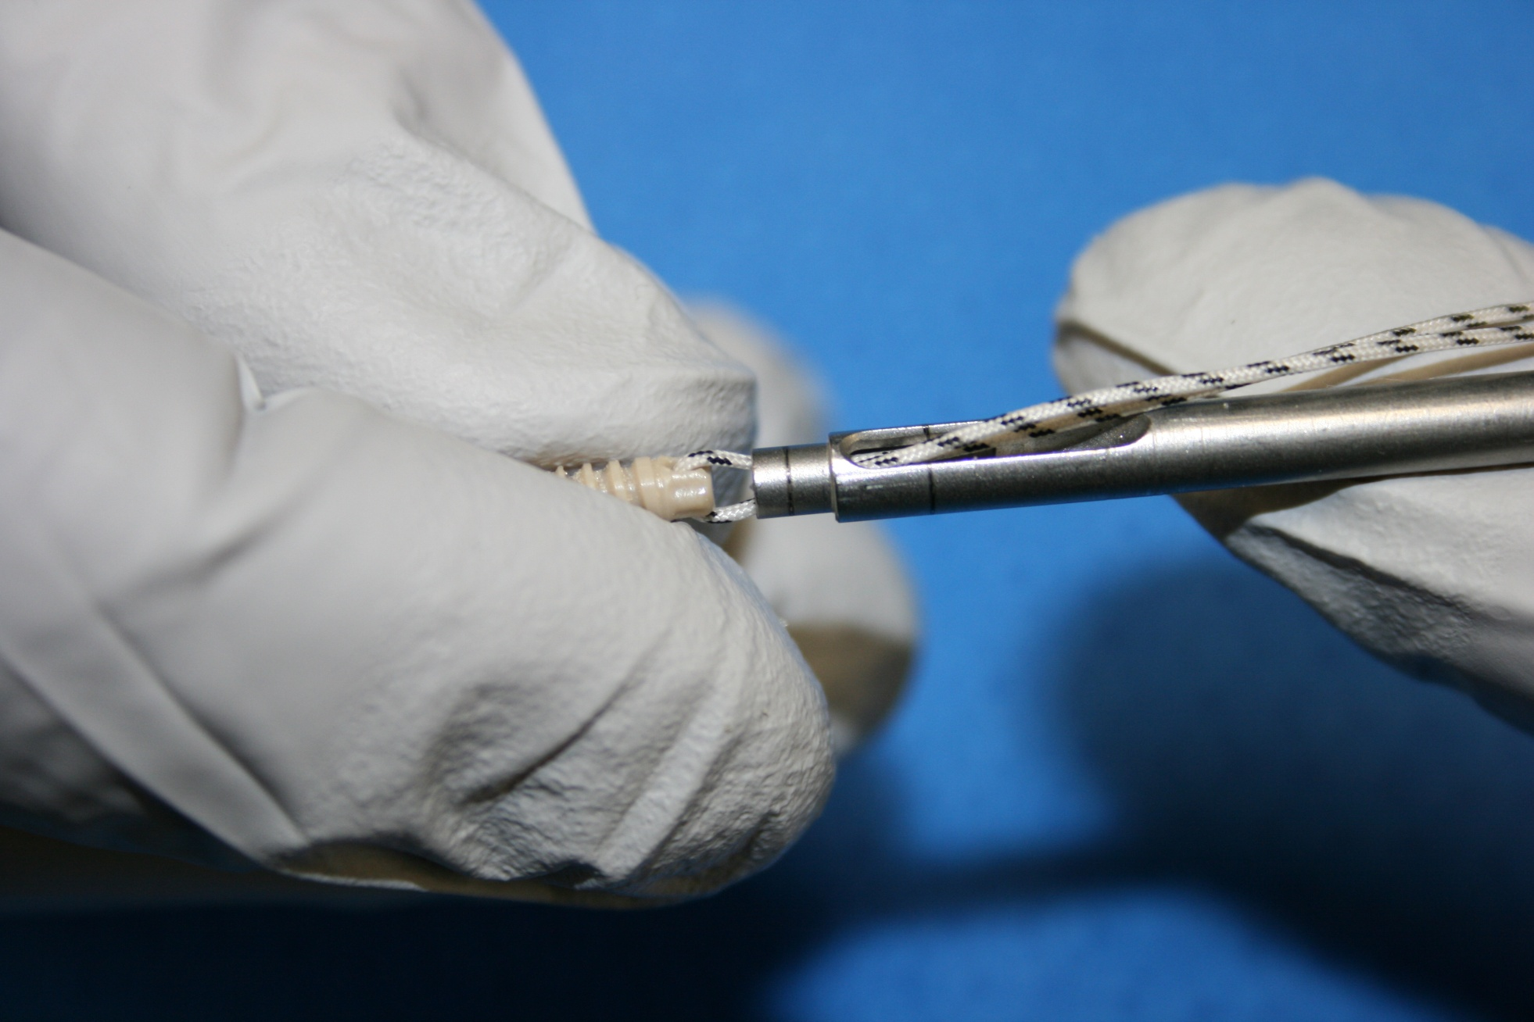
Loading the 2.9mm Anchor Inserter
2.9mm Labral Anchor
STEP 3

Slide 5
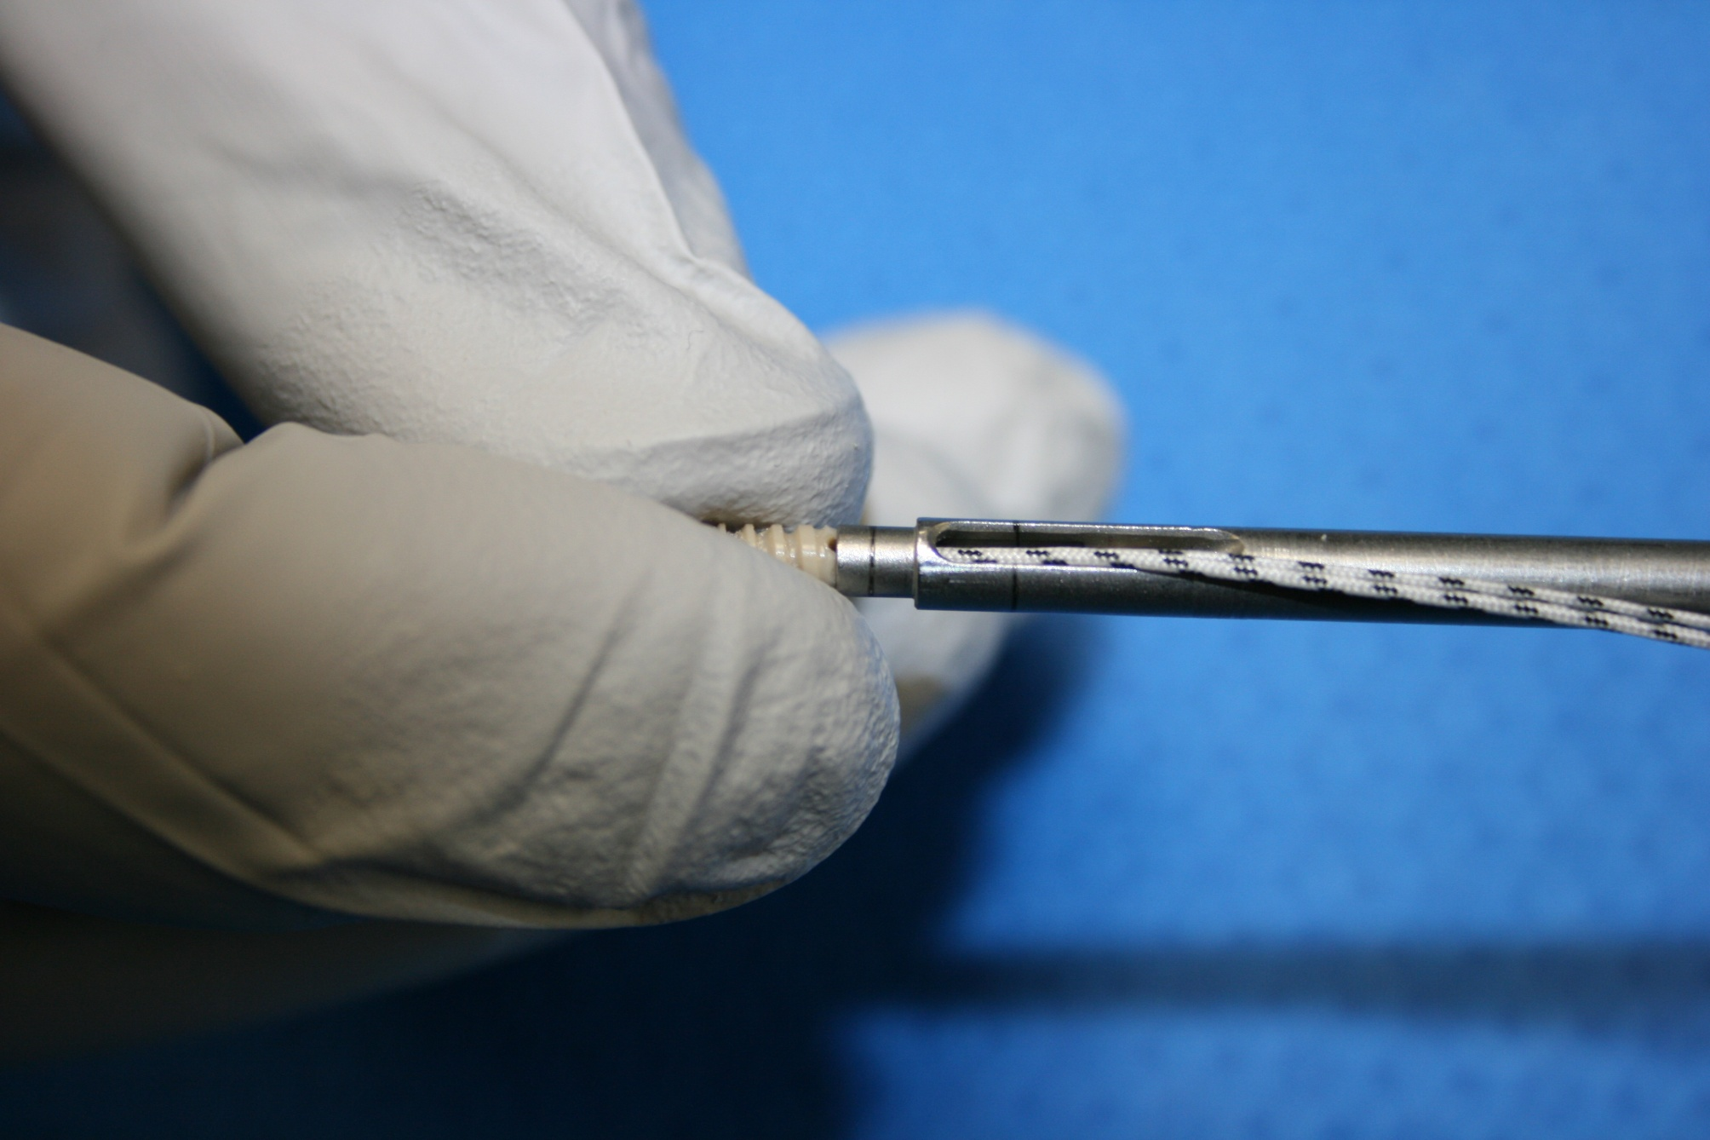
Loading the 2.9mm Anchor Inserter
2.9mm Labral Anchor
STEP 4

Slide 6
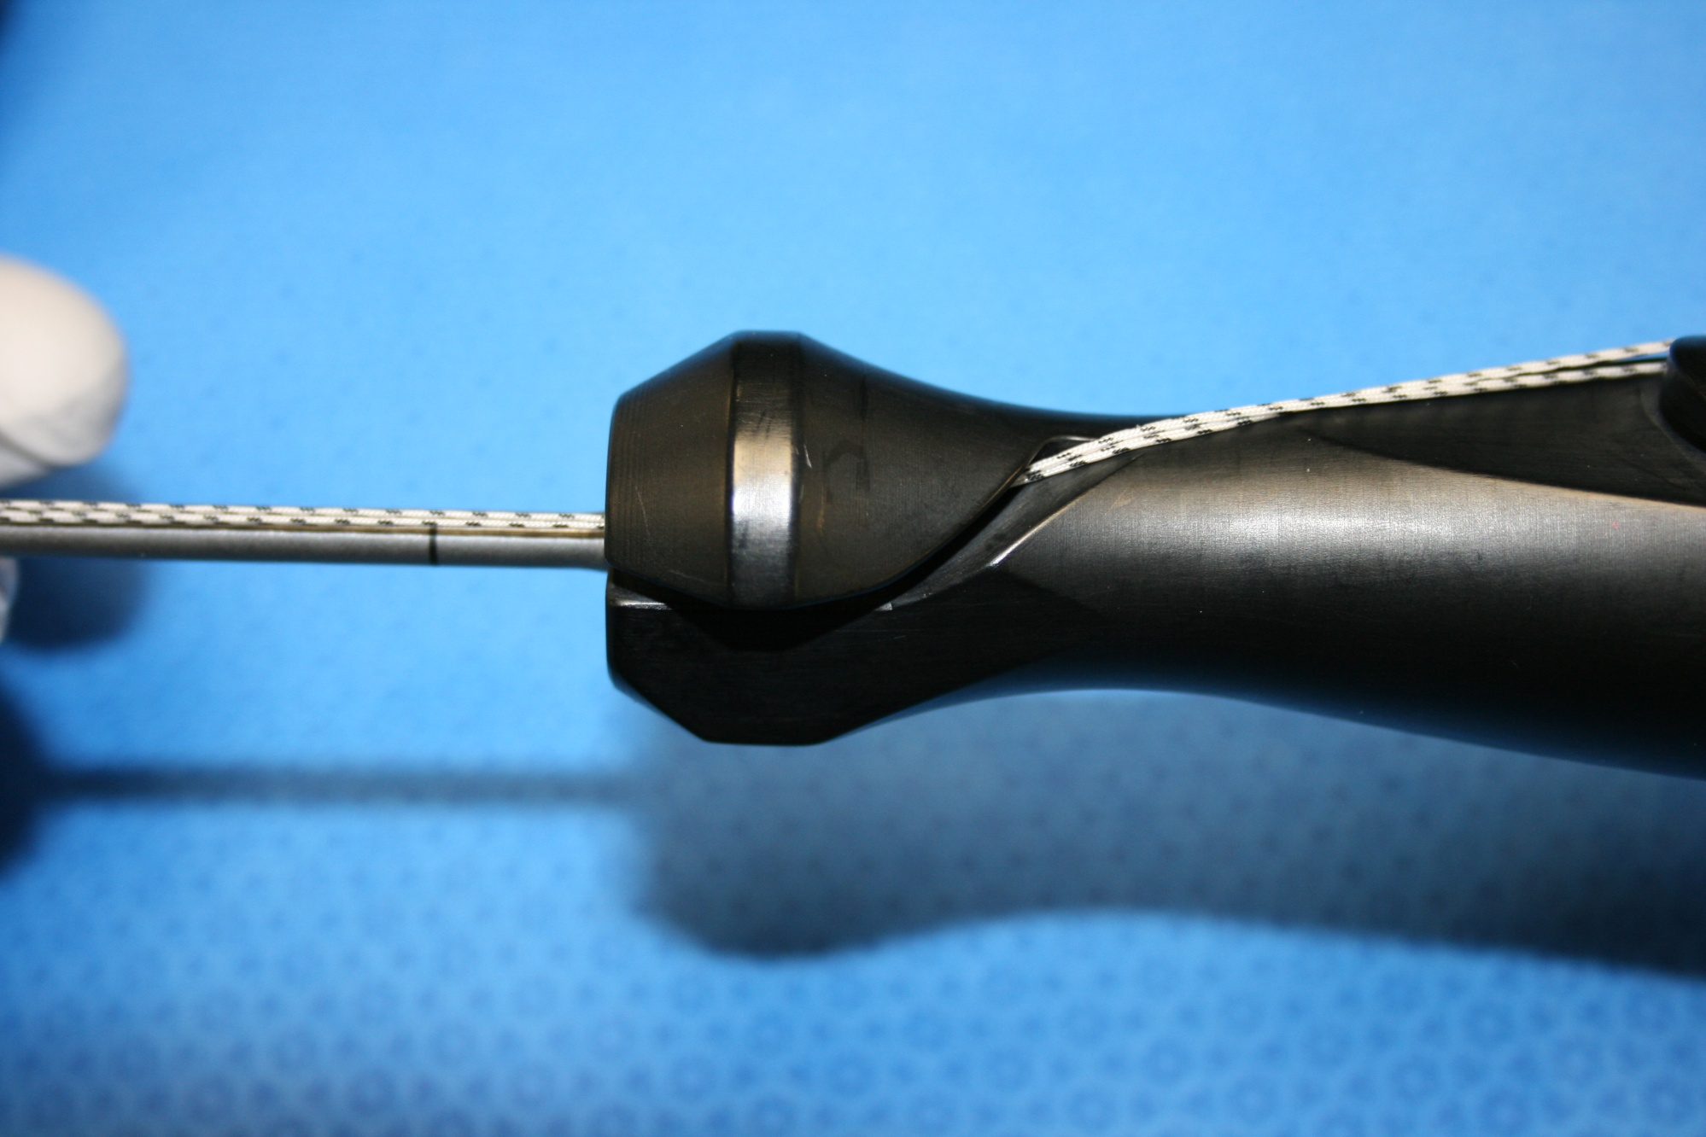
Loading the 2.9mm Anchor Inserter
2.9mm Labral Anchor
STEP 5

Slide 7
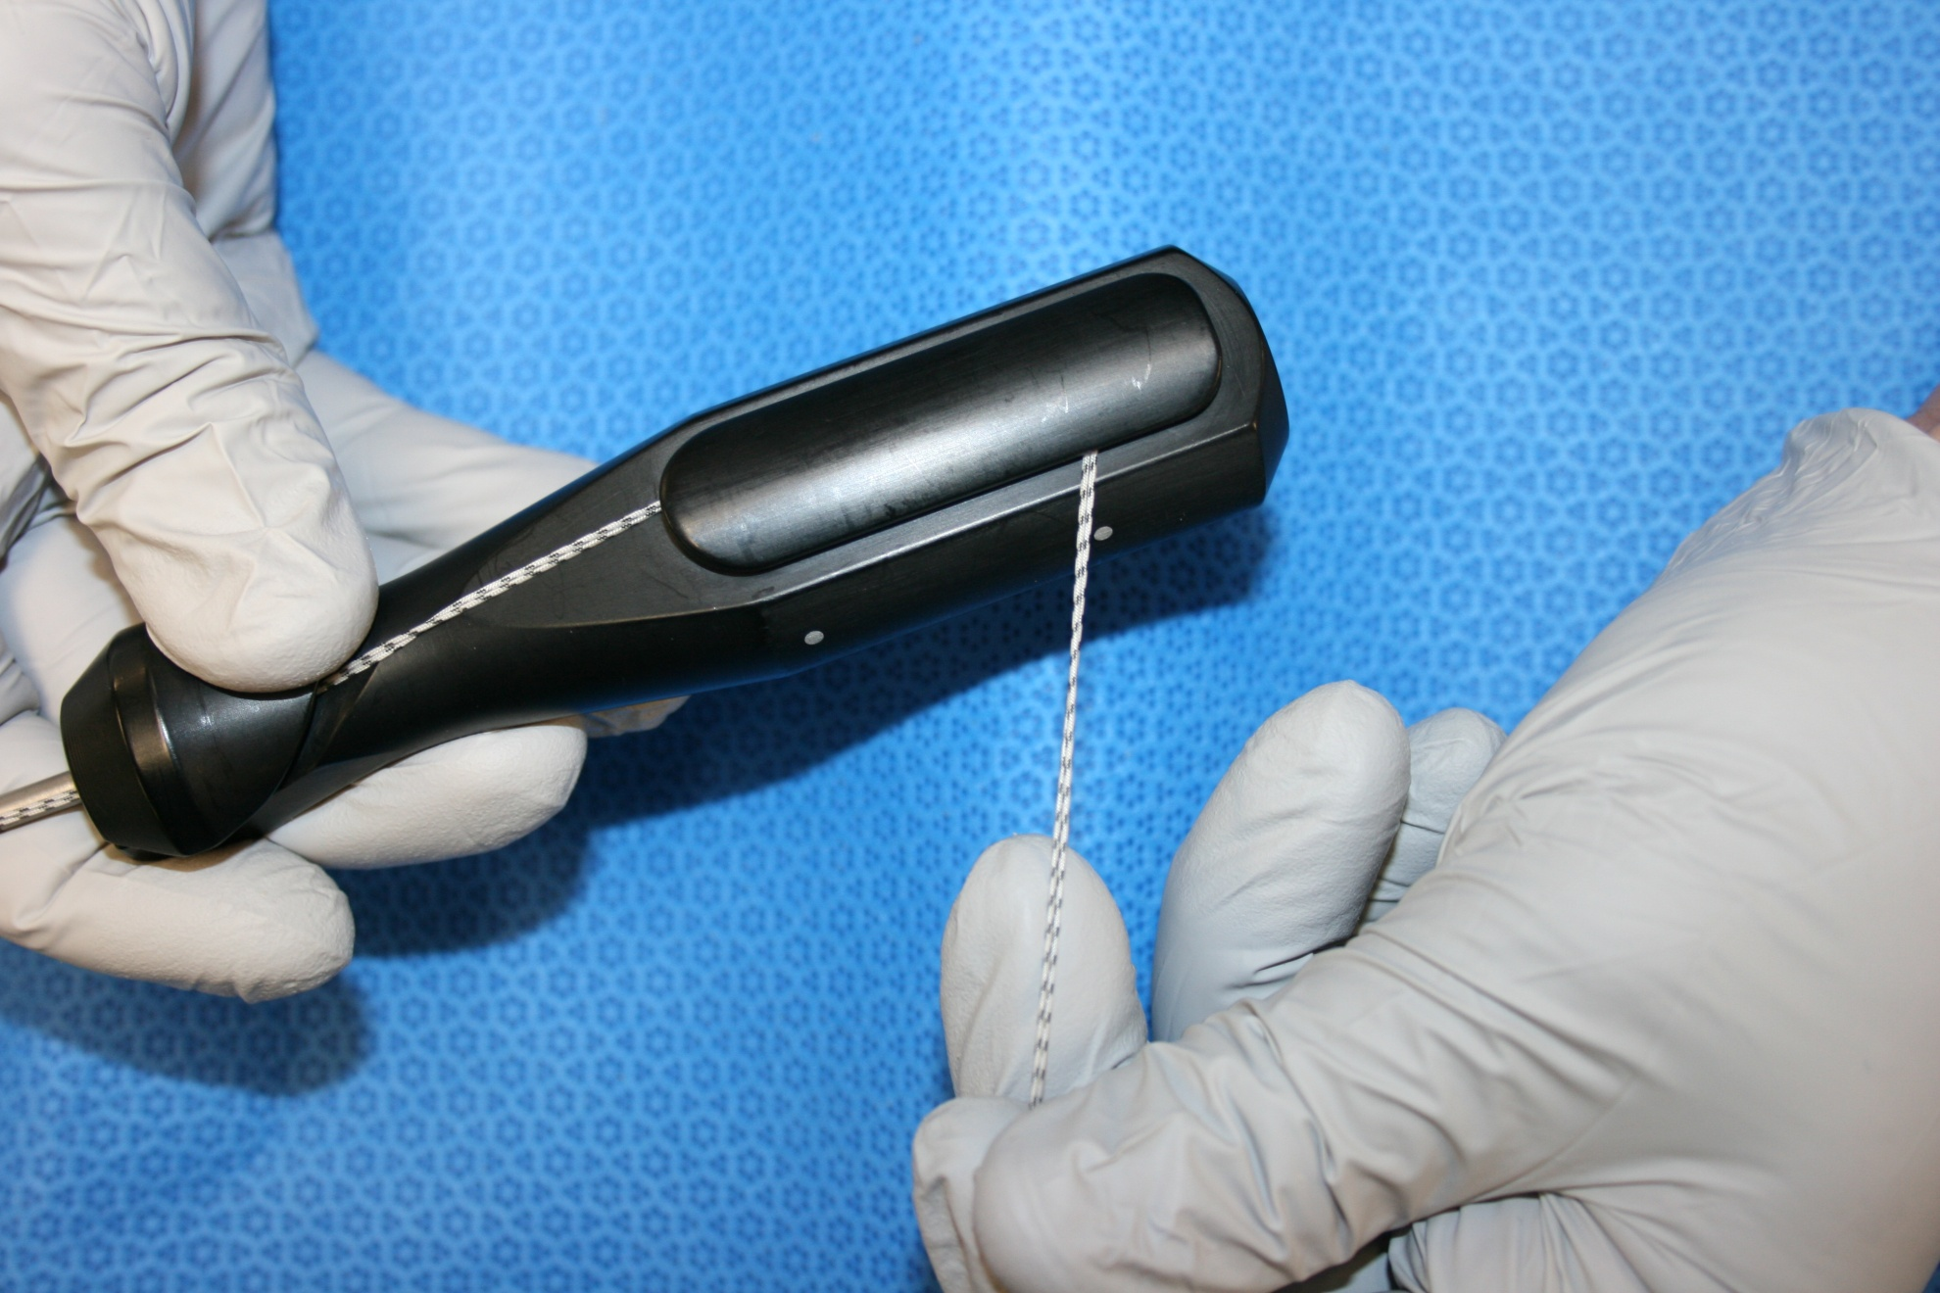
Loading the 2.9mm Anchor Inserter
2.9mm Labral Anchor
STEP 6

Slide 8
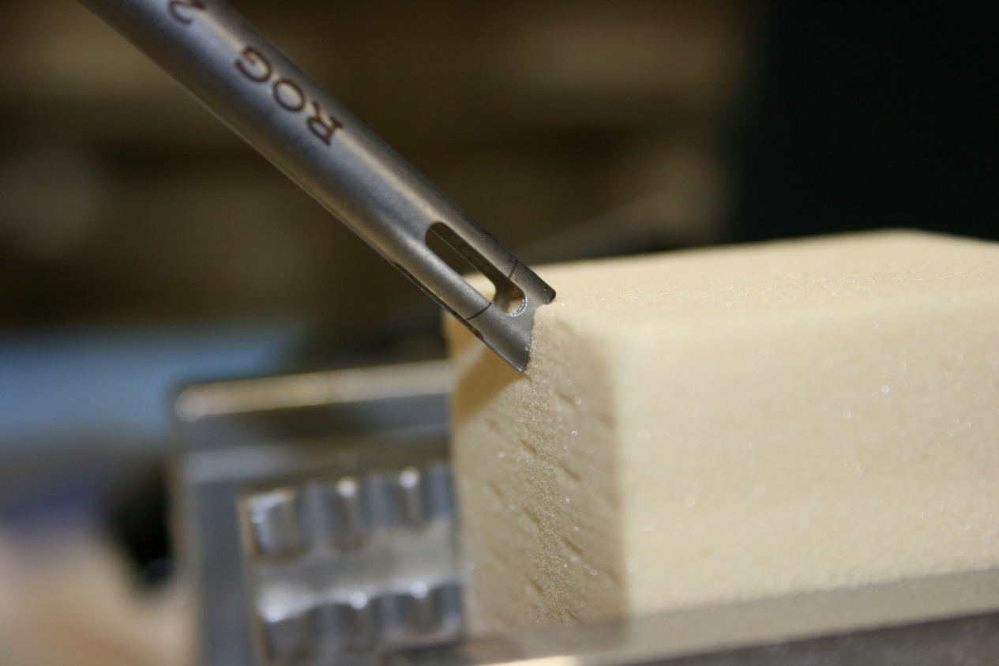
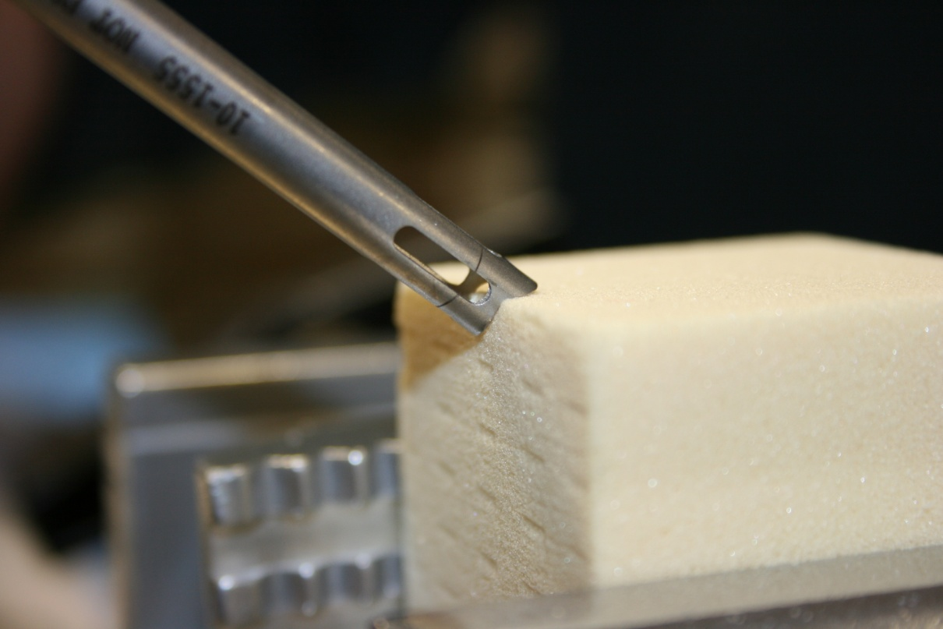
Placement of the 2.9mm Fishmouth Guide
2.9mm Labral Anchor
Step 7
- Fishmouth Design allows for more variability to accommodate surgeon preference.

Slide 9
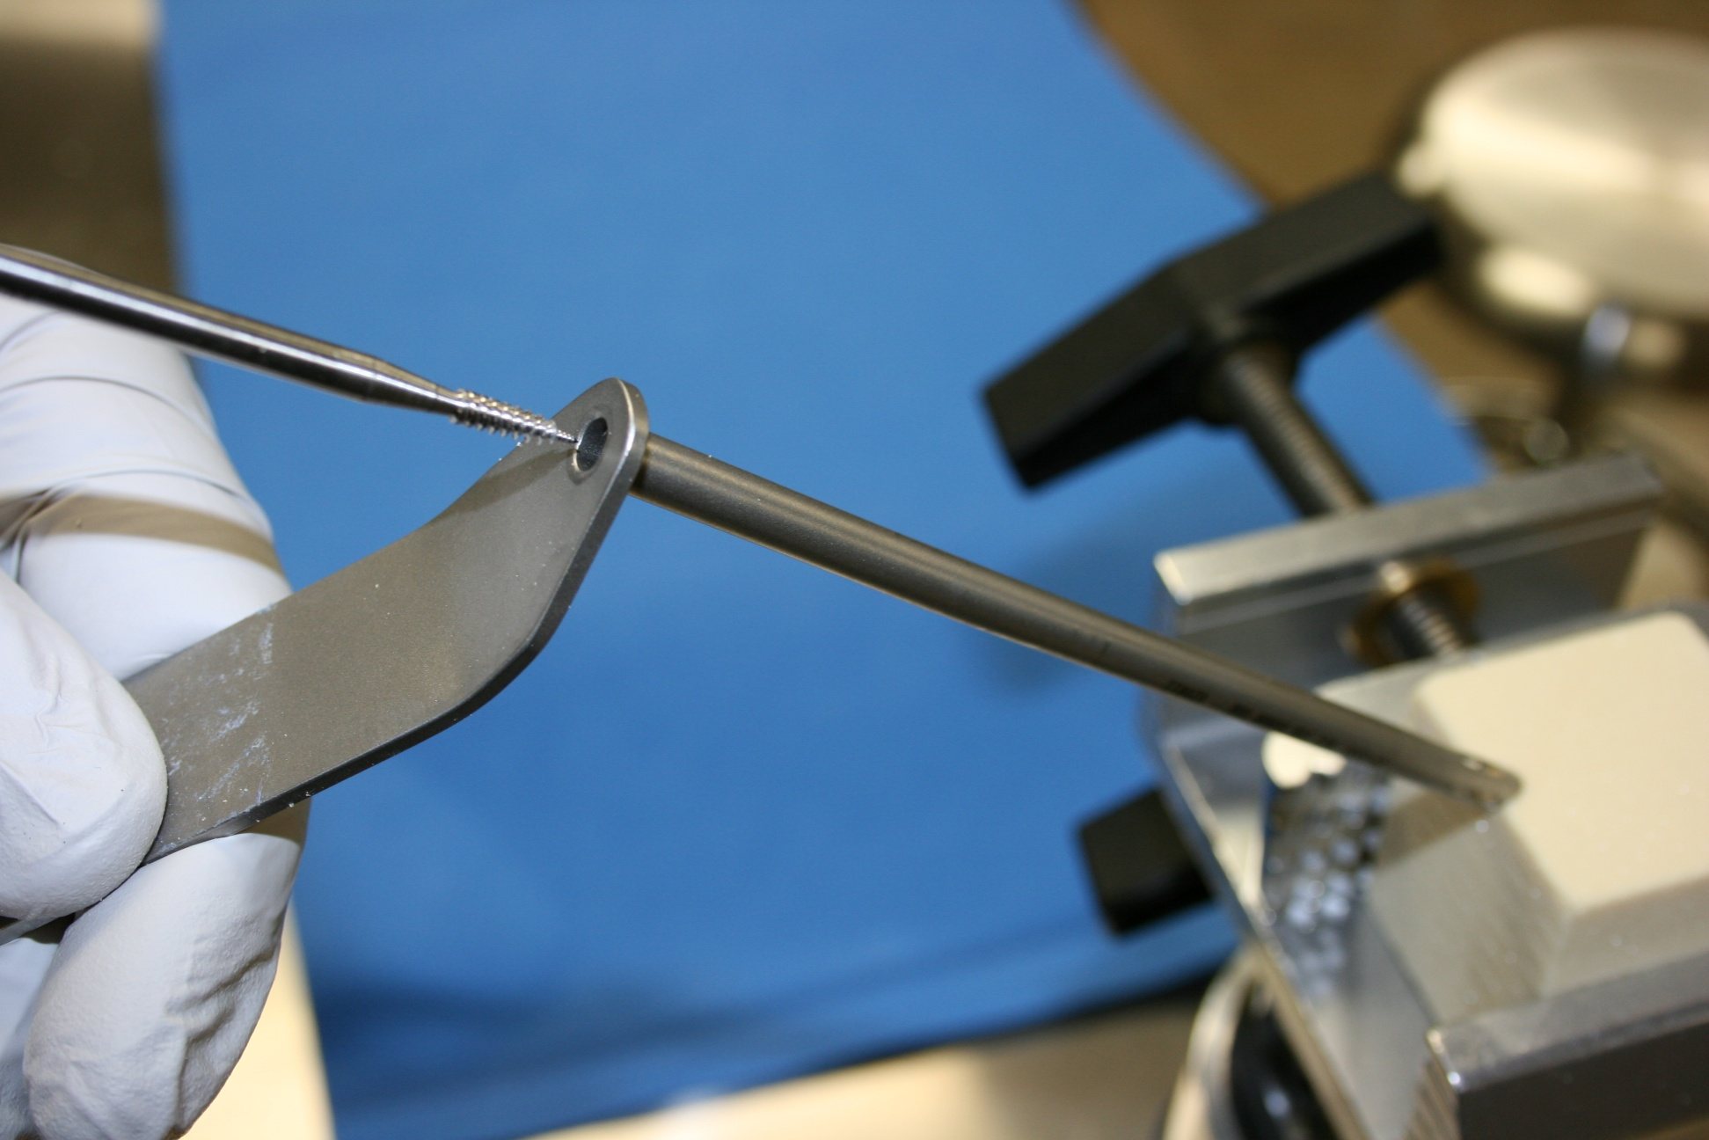
Insert 2.9mm Tap into FishmouthGuide
2.9mm Labral Anchor
Step 8

Slide 10
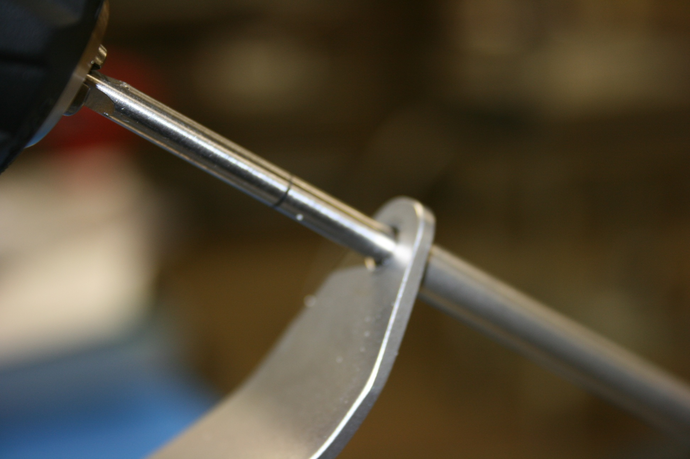
Advance 2.9mm Tap into FishmouthGuide
2.9mm Labral Anchor
Step 9

Slide 11
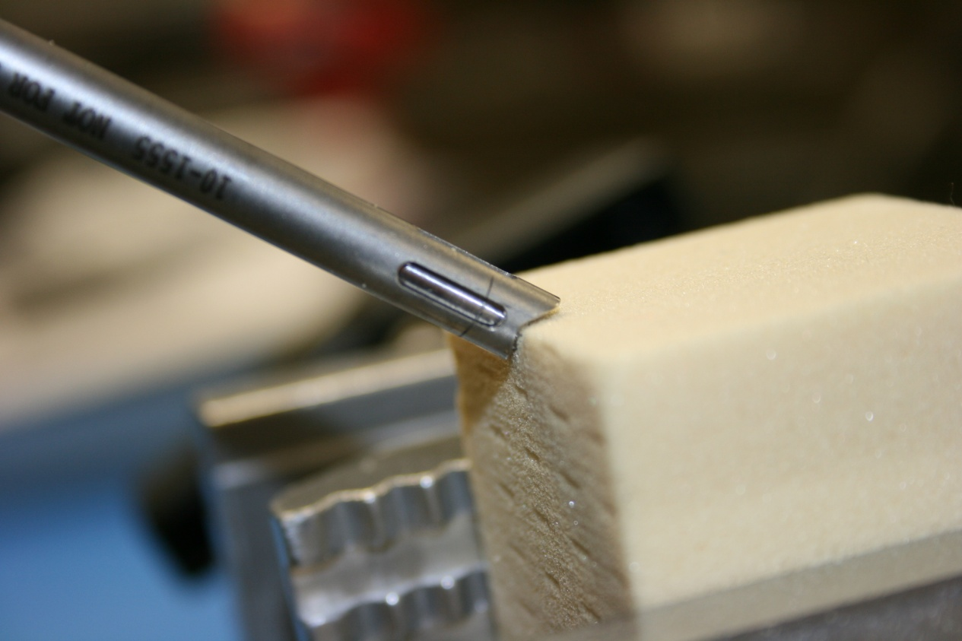
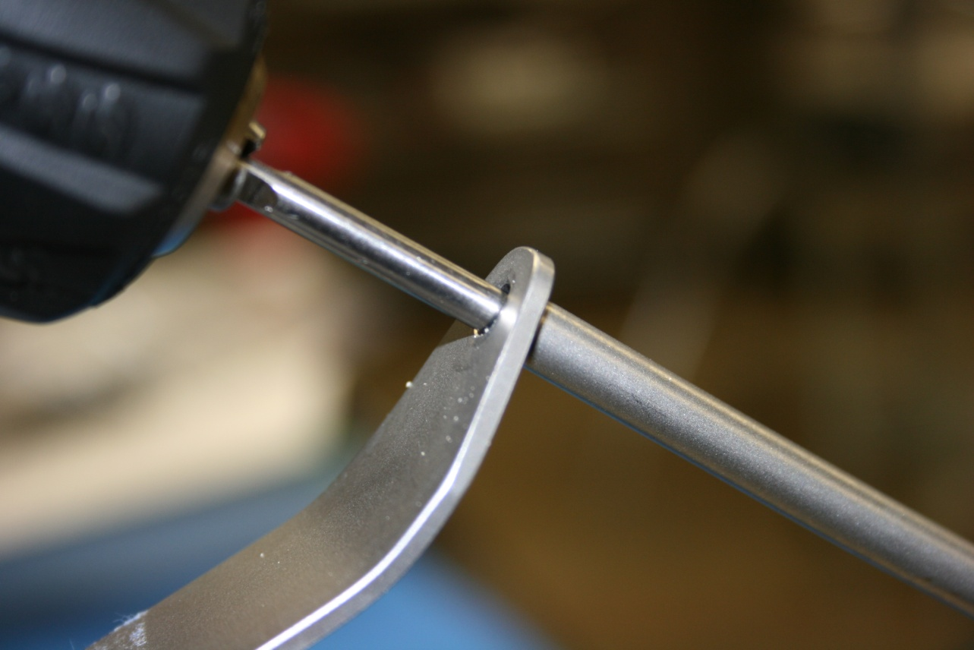
Stop when corresponding lines are aligned
2.9mm Labral Anchor
Step 10

Slide 12
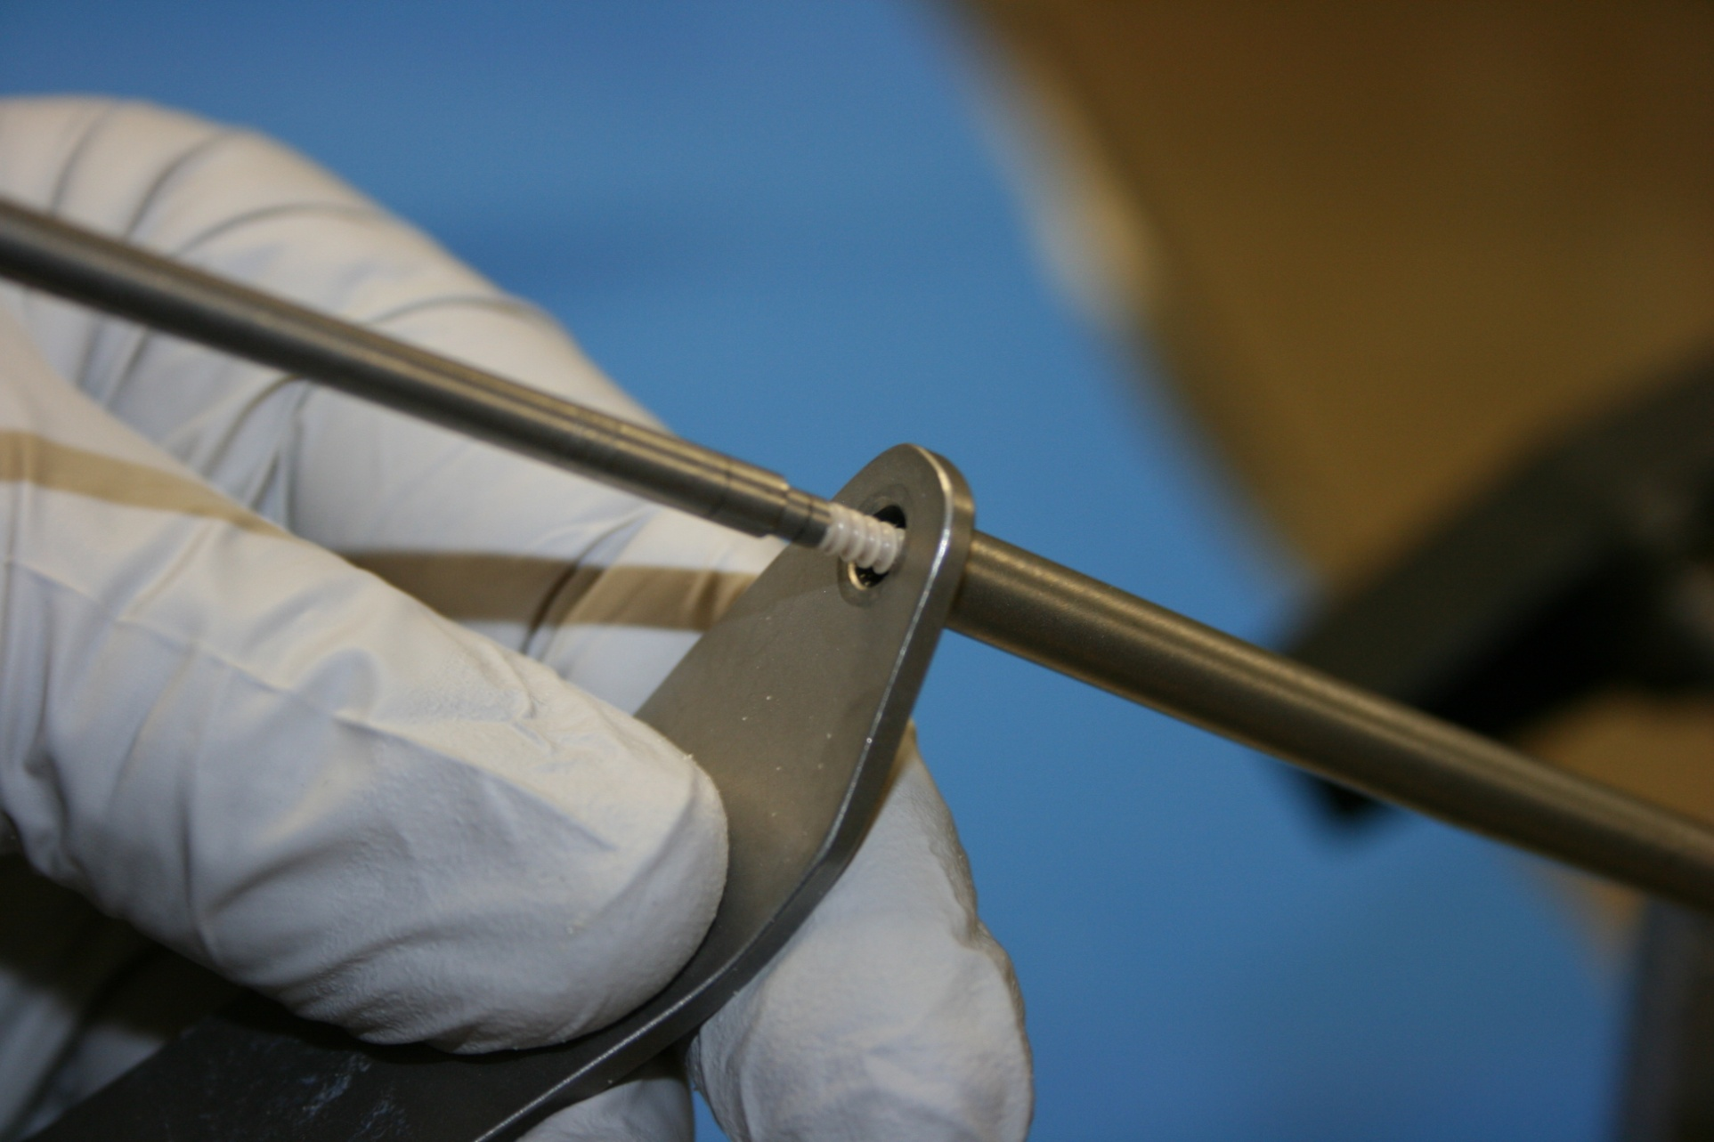
Insert 2.9mm Inserter into Fishmouth Guide
2.9mm Labral Anchor
Step 11

Slide 13
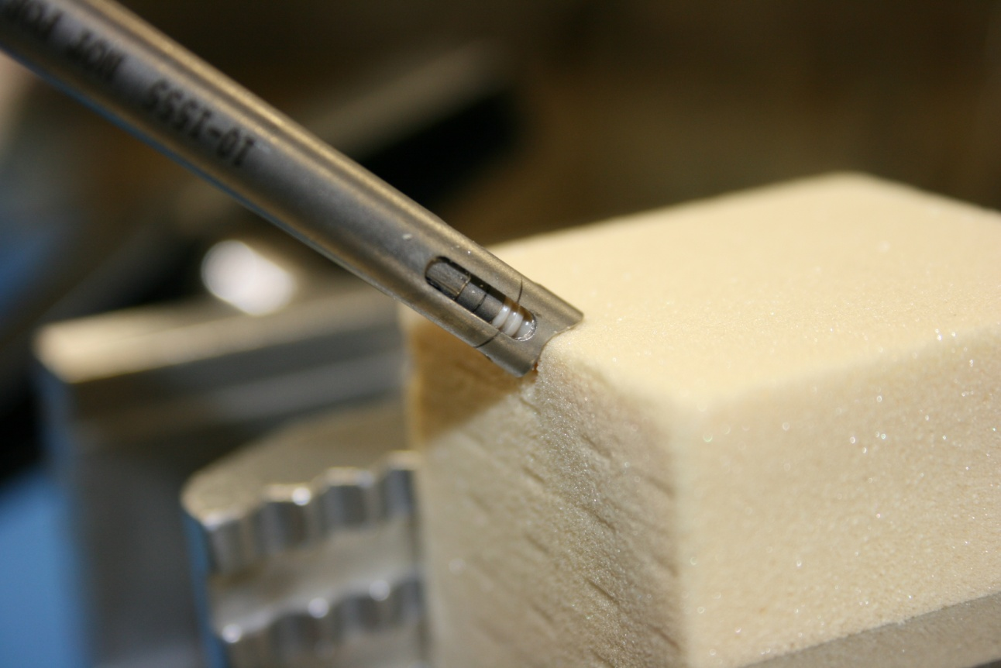
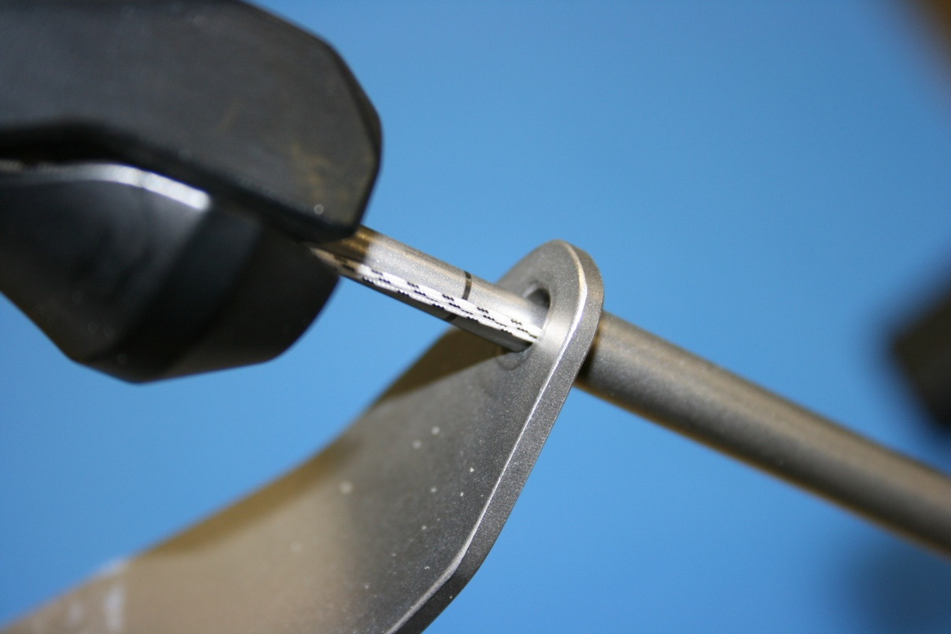
Advance 2.9mm Inserter into FishmouthGuide
2.9mm Labral Anchor
Step 12

Slide 14
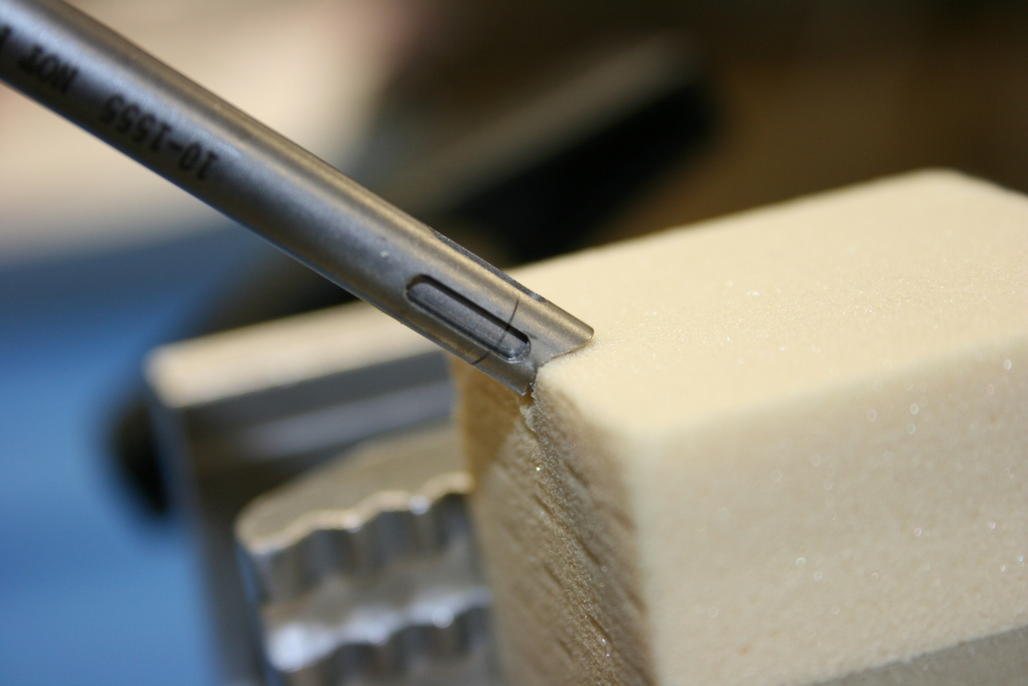
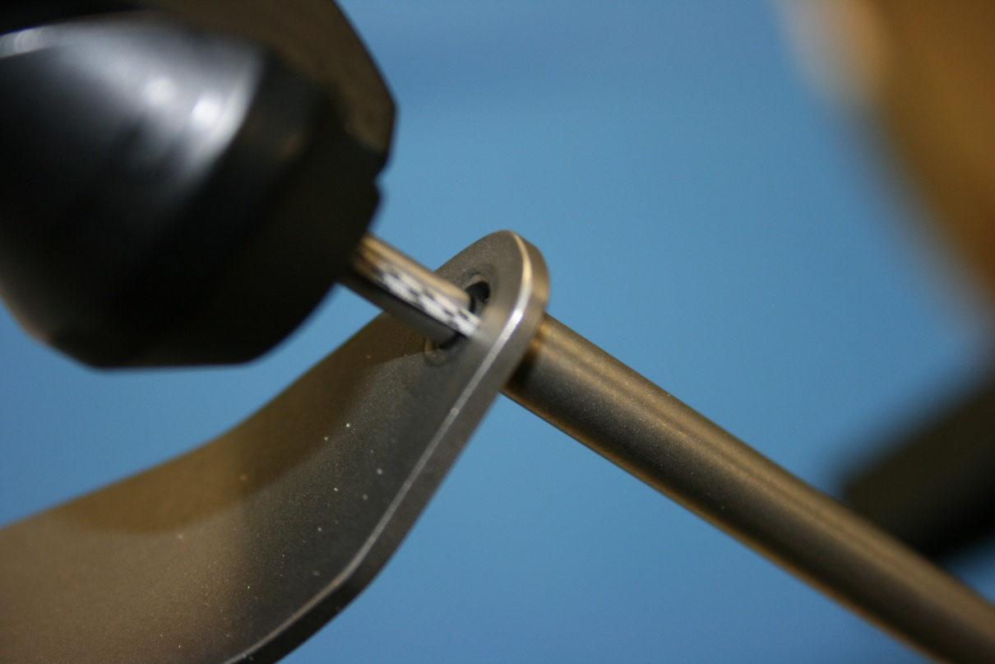
Stop when corresponding lines are aligned
2.9mm Labral Anchor
Step 13

Slide 15
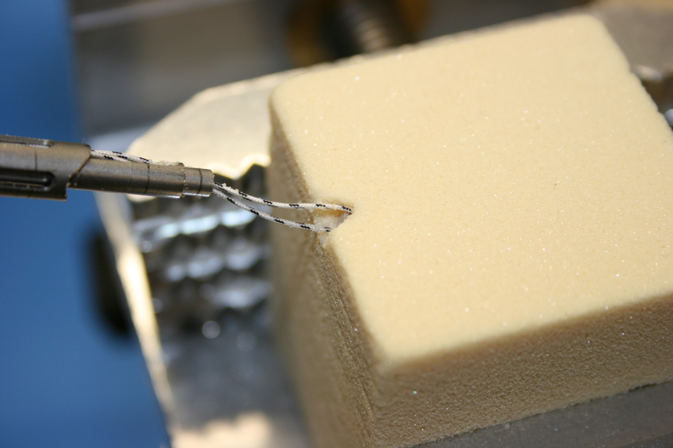
Unload Anchor and Remove 2.9mm Inserter
2.9mm Labral Anchor
Step 14

