Slide 1

Surgical Technique
5.5 Knotless Anchor

Slide 2
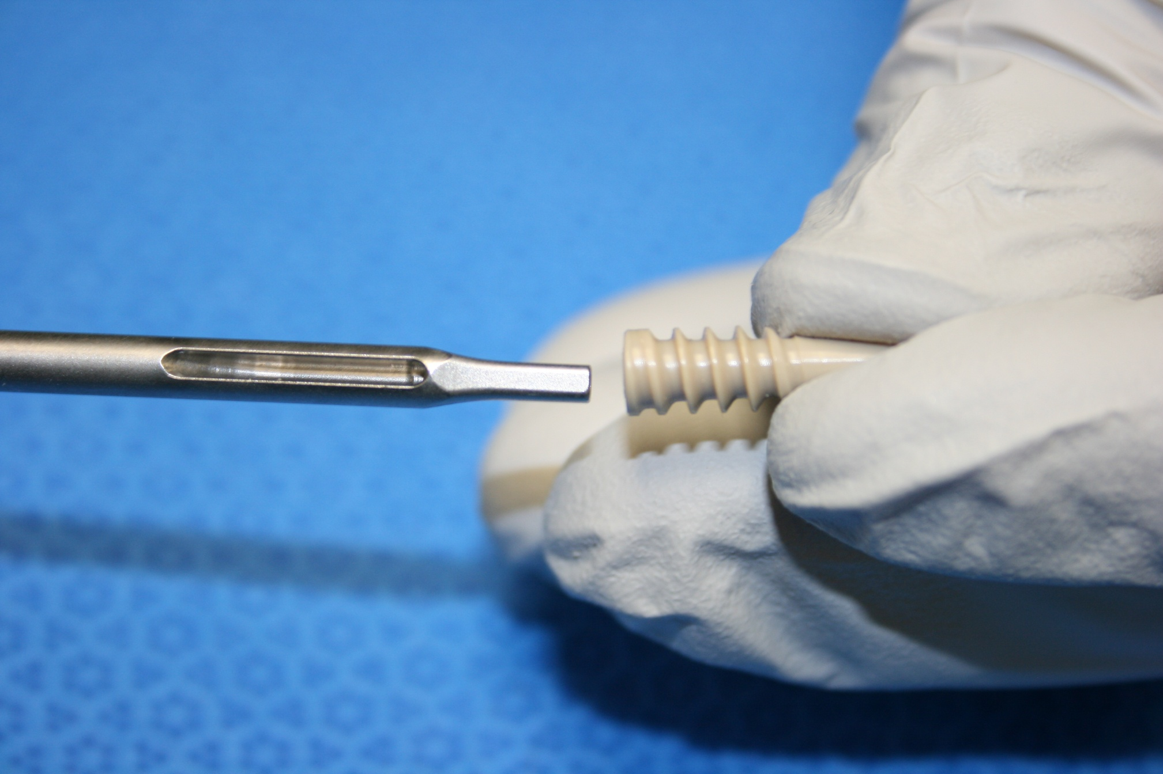
Loading the 5.5mm Knotless Anchor
5.5mm Knotless Anchor
STEP 1

Slide 3
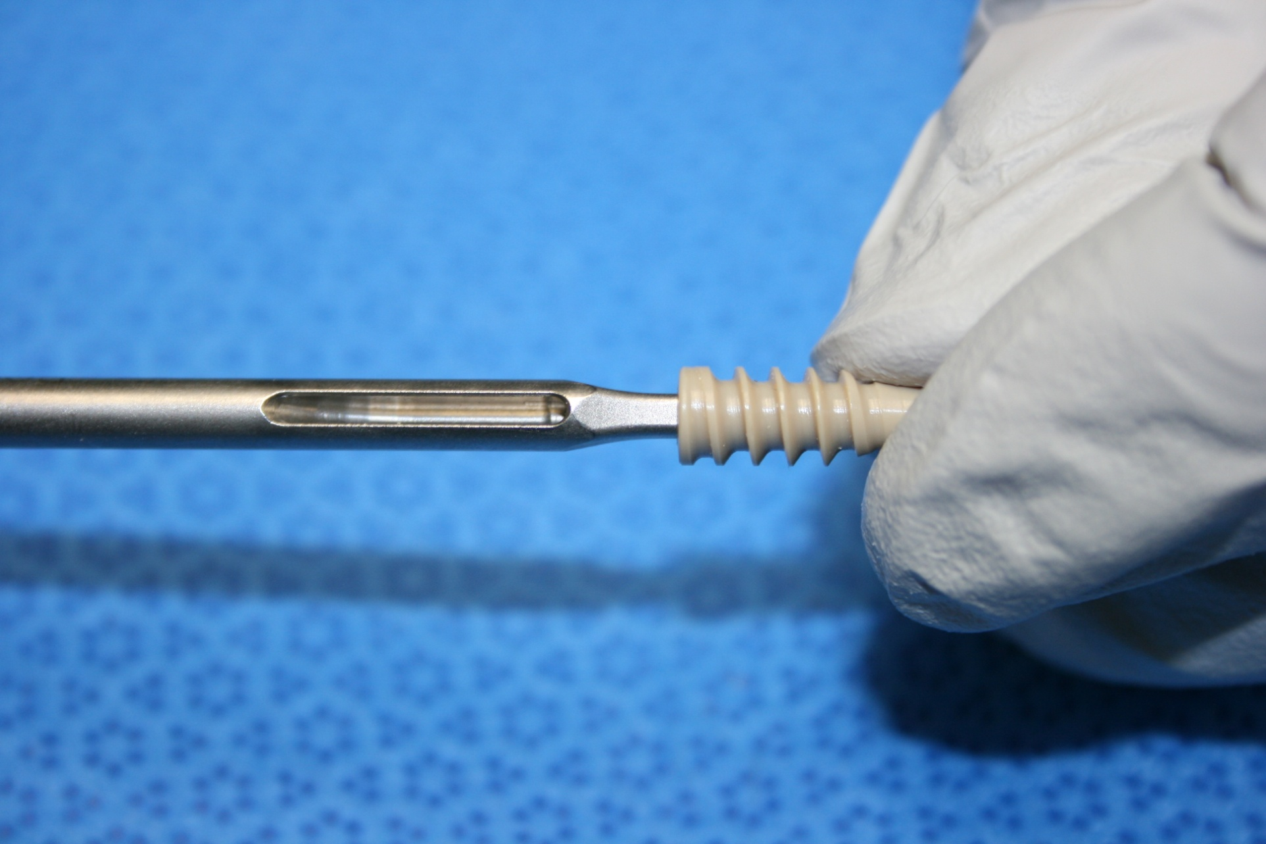
Loading the 5.5mm Knotless Anchor
5.5mm Knotless Anchor
STEP 2

Slide 4
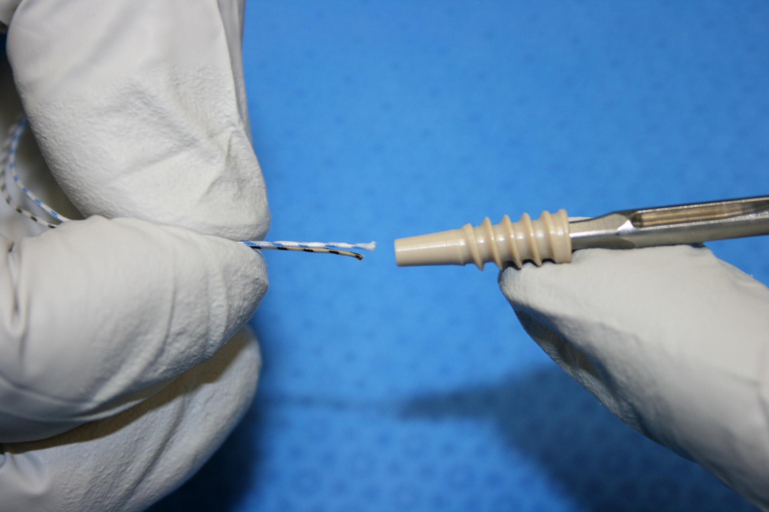
Loading the 5.5mm Knotless Anchor Inserter
5.5mm Knotless Anchor
STEP 3

Slide 5
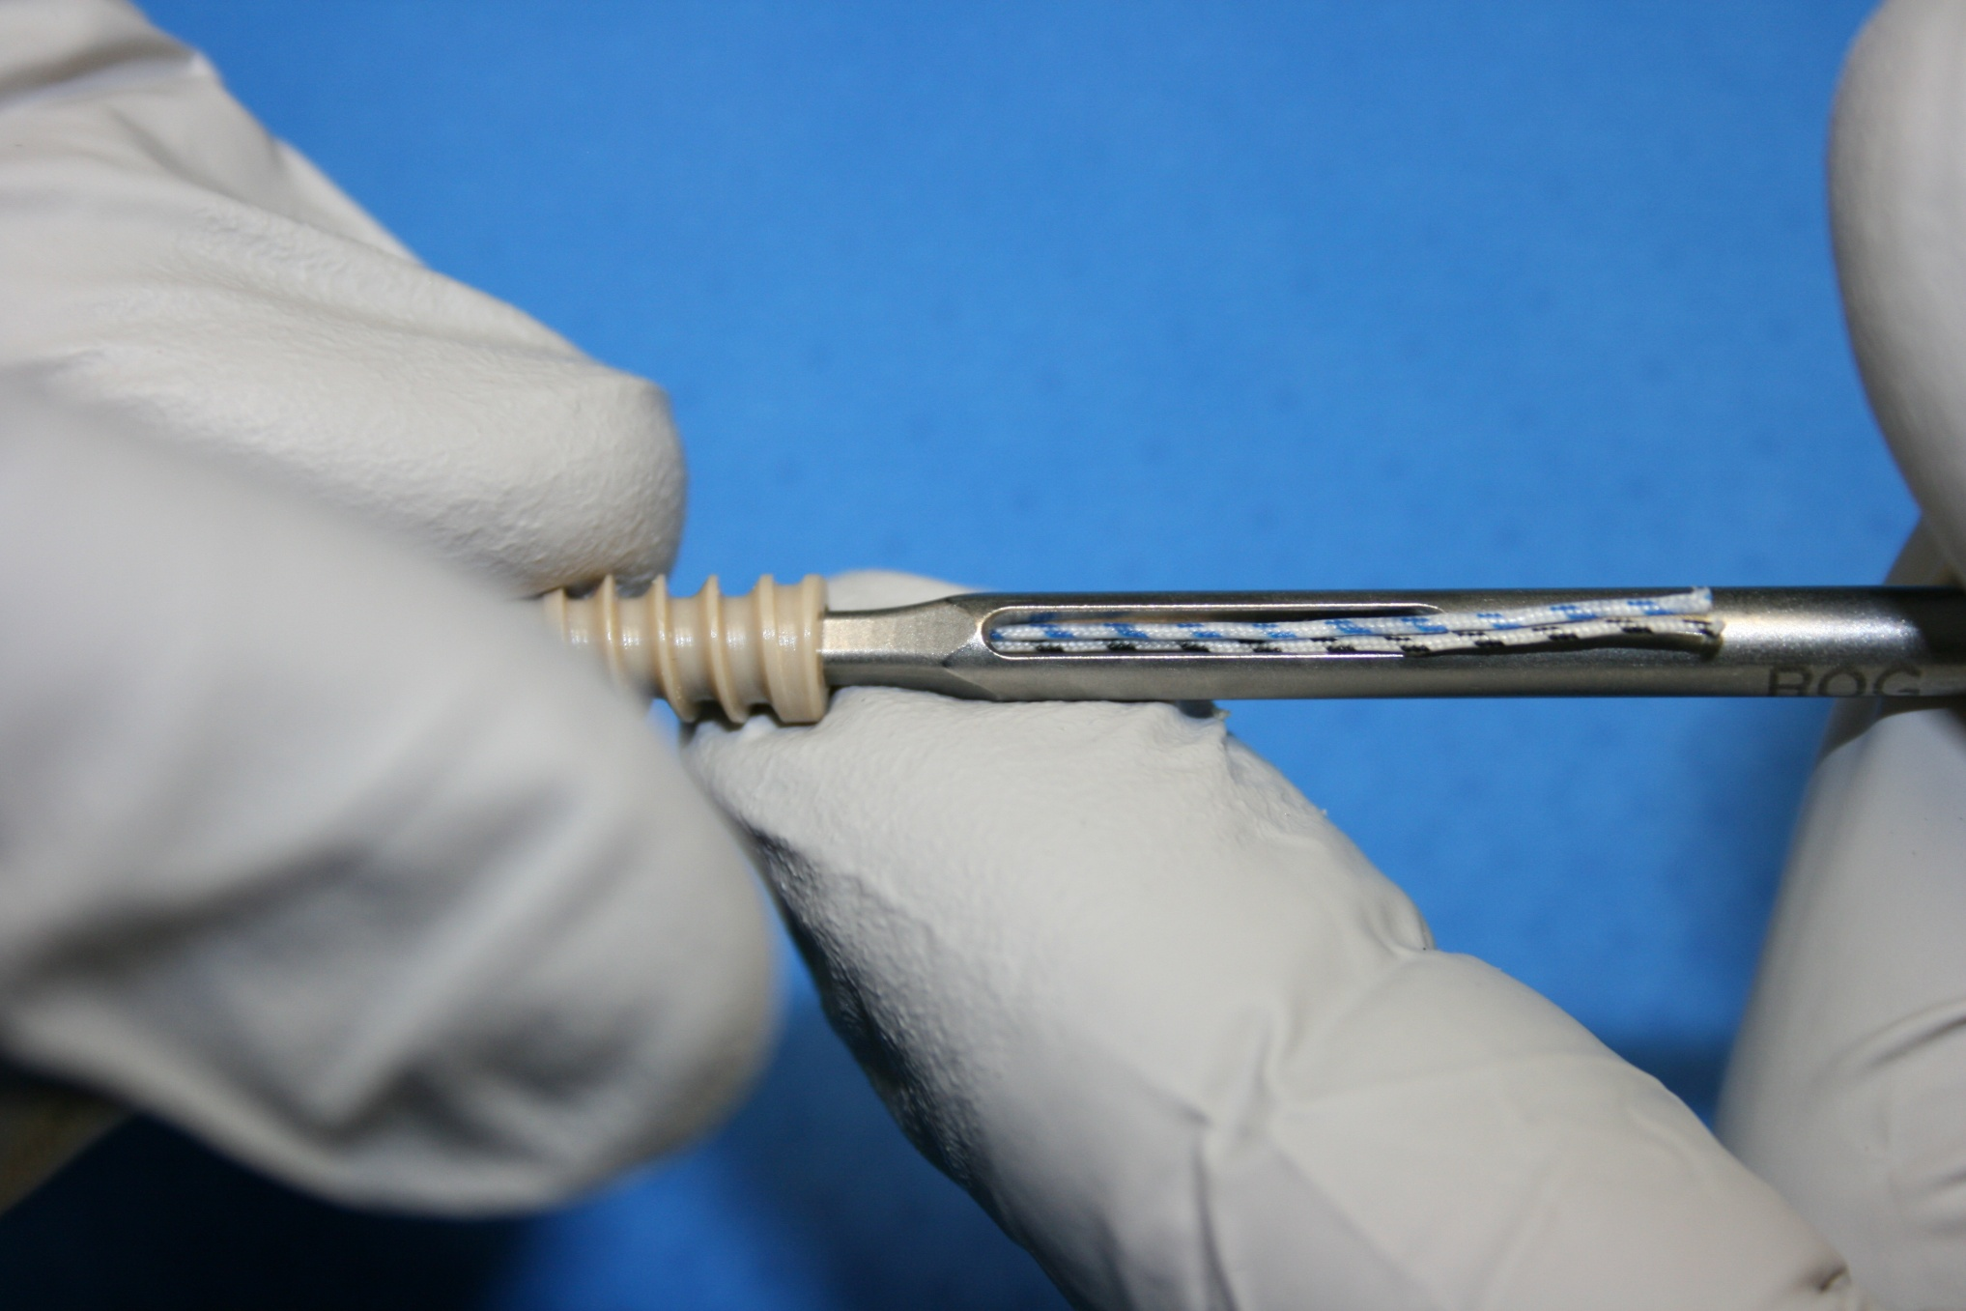
Loading the 5.5mm Knotless Anchor Inserter
5.5mm Knotless Anchor
STEP 4

Slide 6
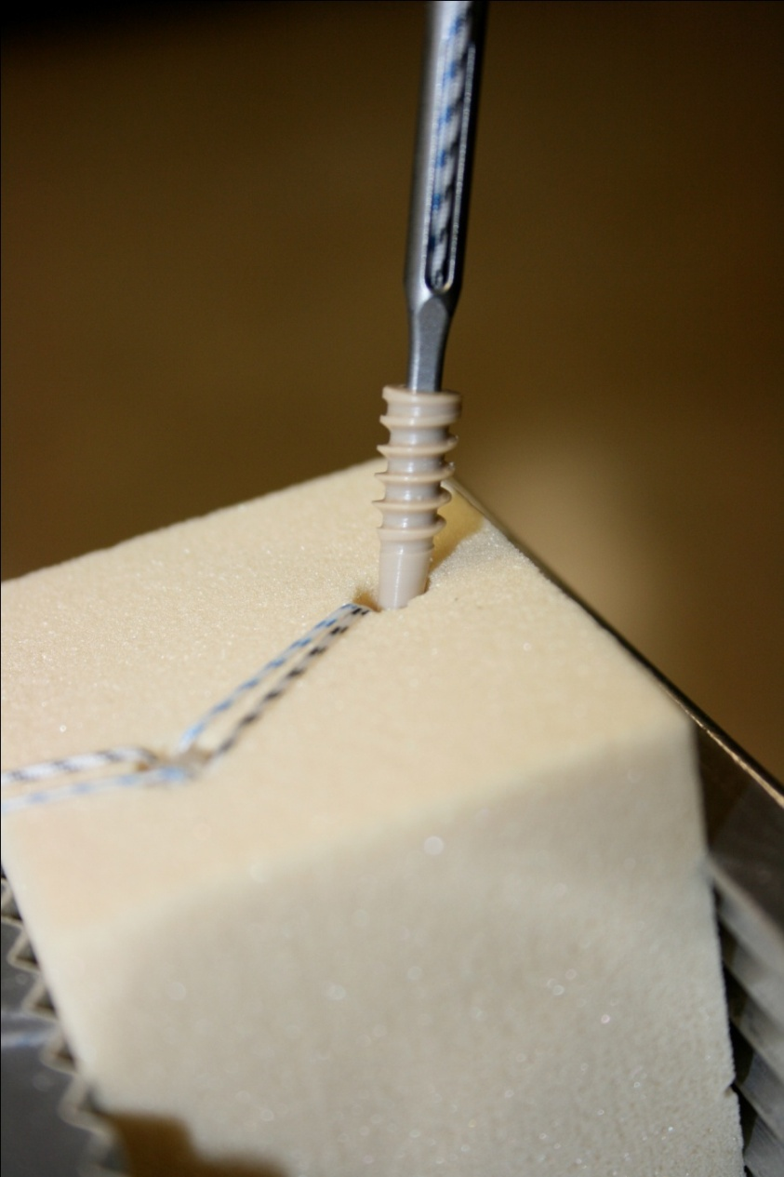
Place 5.5mm Knotless Anchor at Pre-tapped hole
5.5mm Knotless Anchor
STEP 5

Slide 7
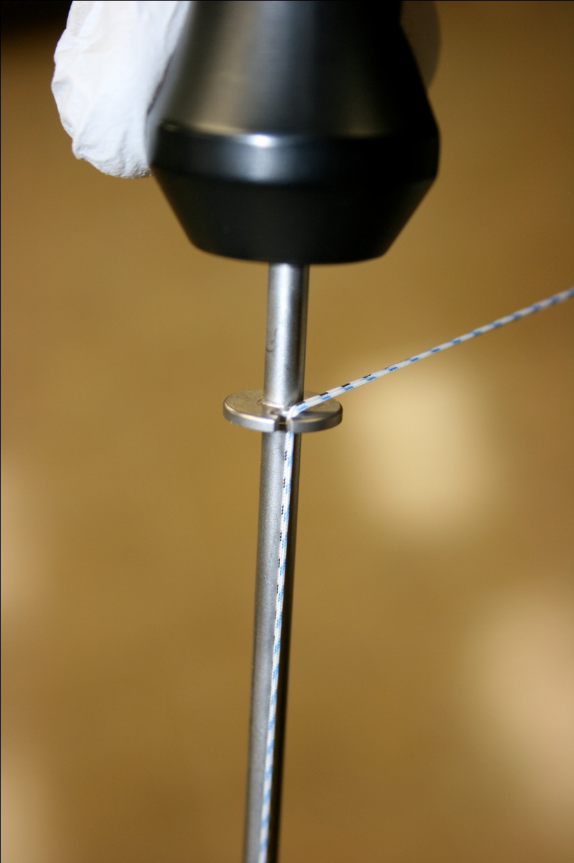
Gain Tension and Load Suture in Suture Ring
5.5mm Knotless Anchor
STEP 6

Slide 8
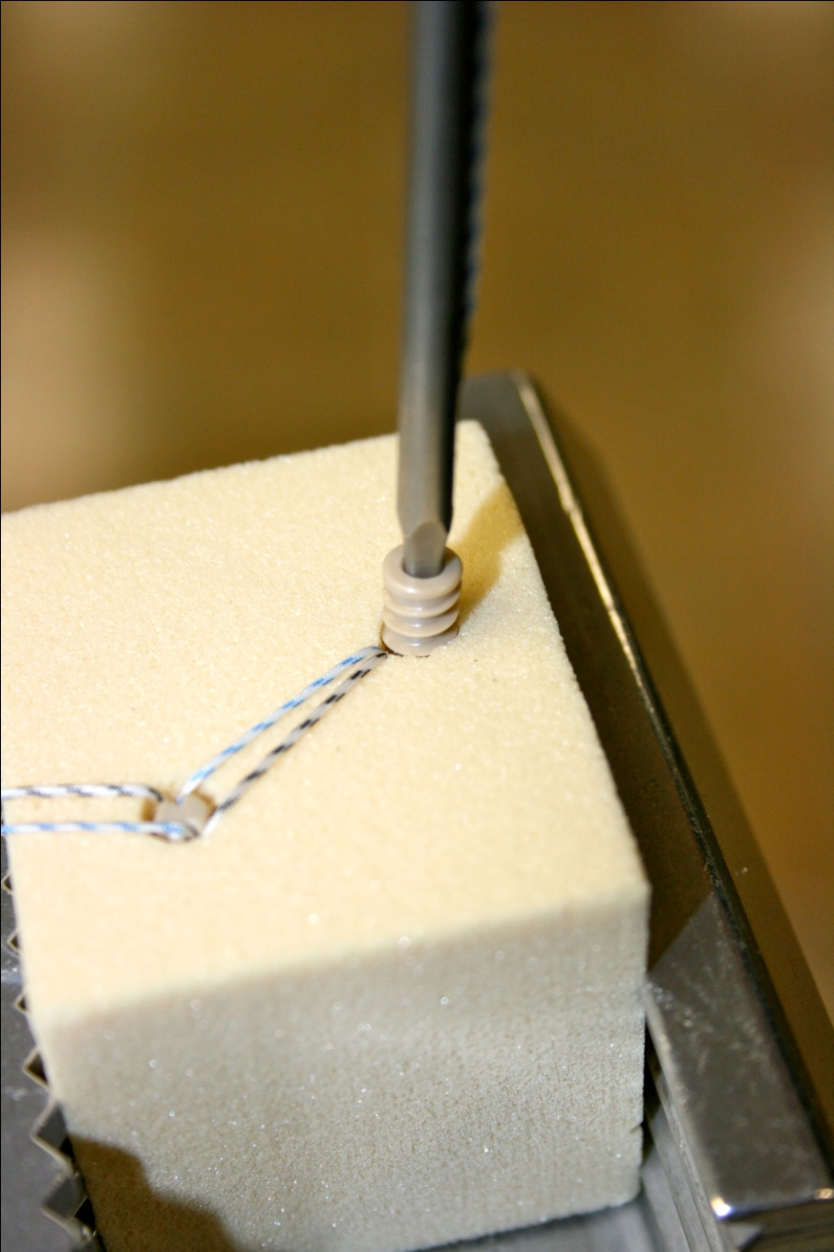
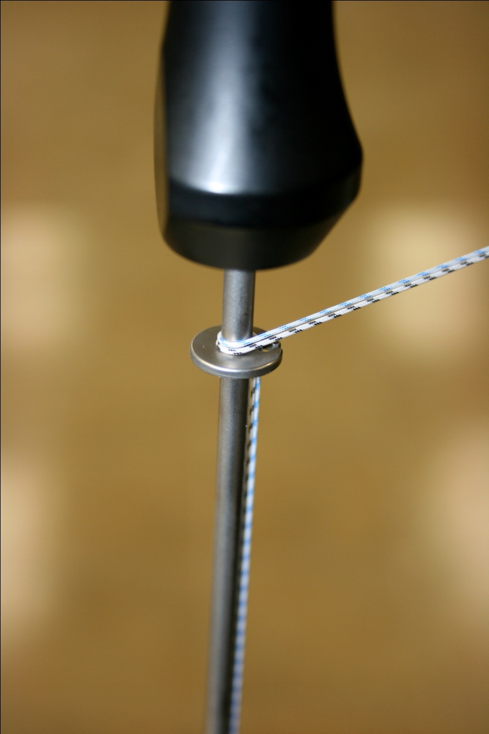
Advance 5.5mm Anchor 1 Full Turn into hole while Maintaining Tension
5.5mm Knotless Anchor
STEP 7

Slide 9
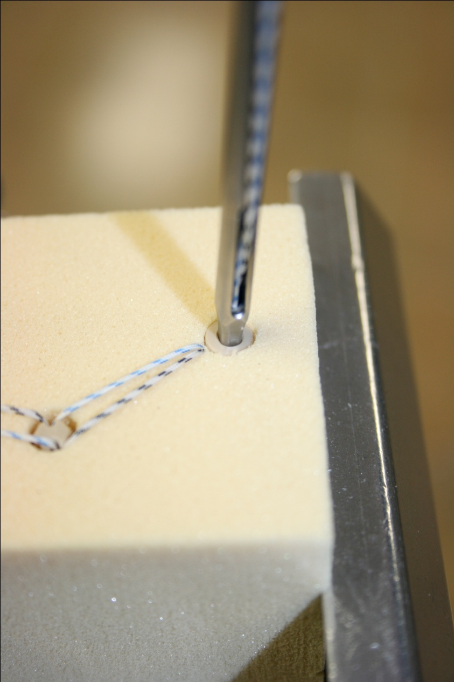
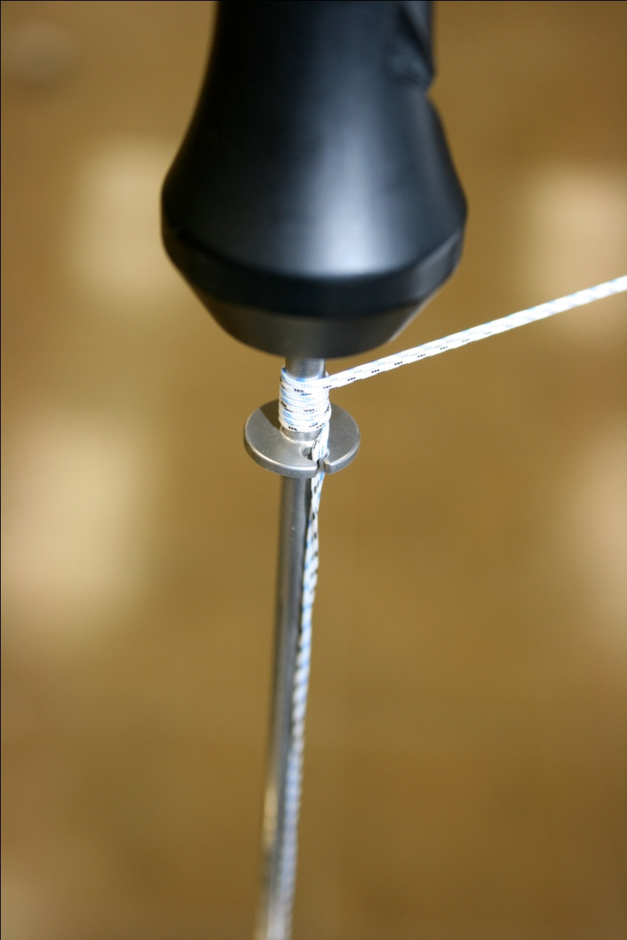
Release Tension on suture but keep in Suture Ring and advance 5.5mm Knotless Anchor until flush with bone
5.5mm Knotless Anchor
STEP 8

Slide 10
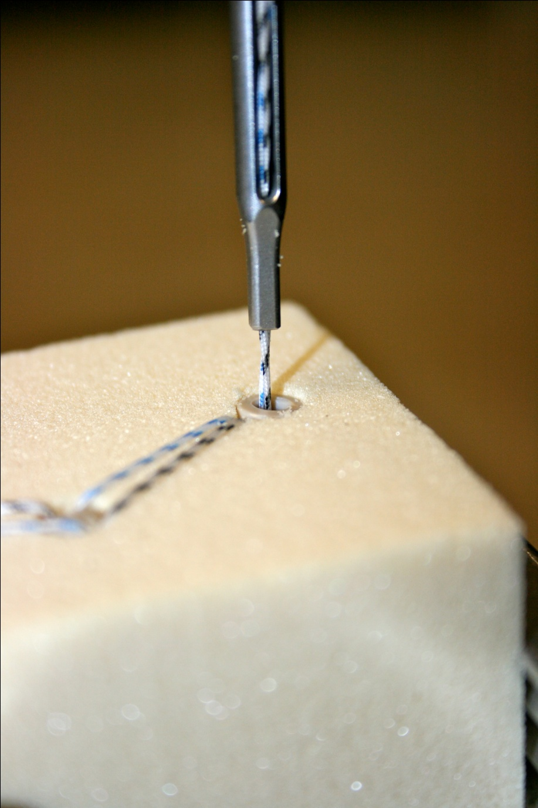
Unload and Remove 5.5mm Knotless Inserter
5.5mm Knotless Anchor
STEP 9

