Slide 1

Surgical Technique
5.5Anchor

Slide 2
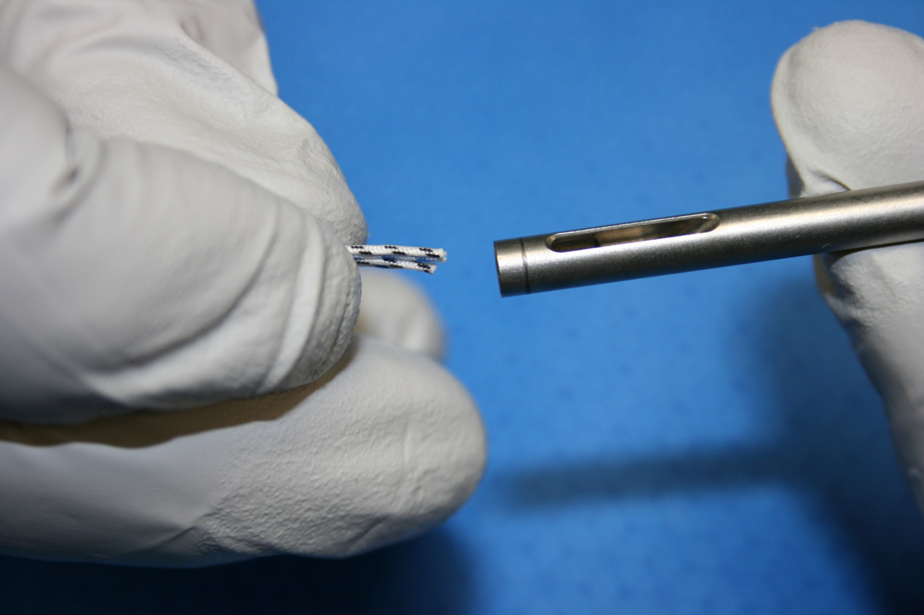
Loading the 5.5mm Cuff Anchor Inserter
5.5mm Cuff Anchor
STEP 1

Slide 3
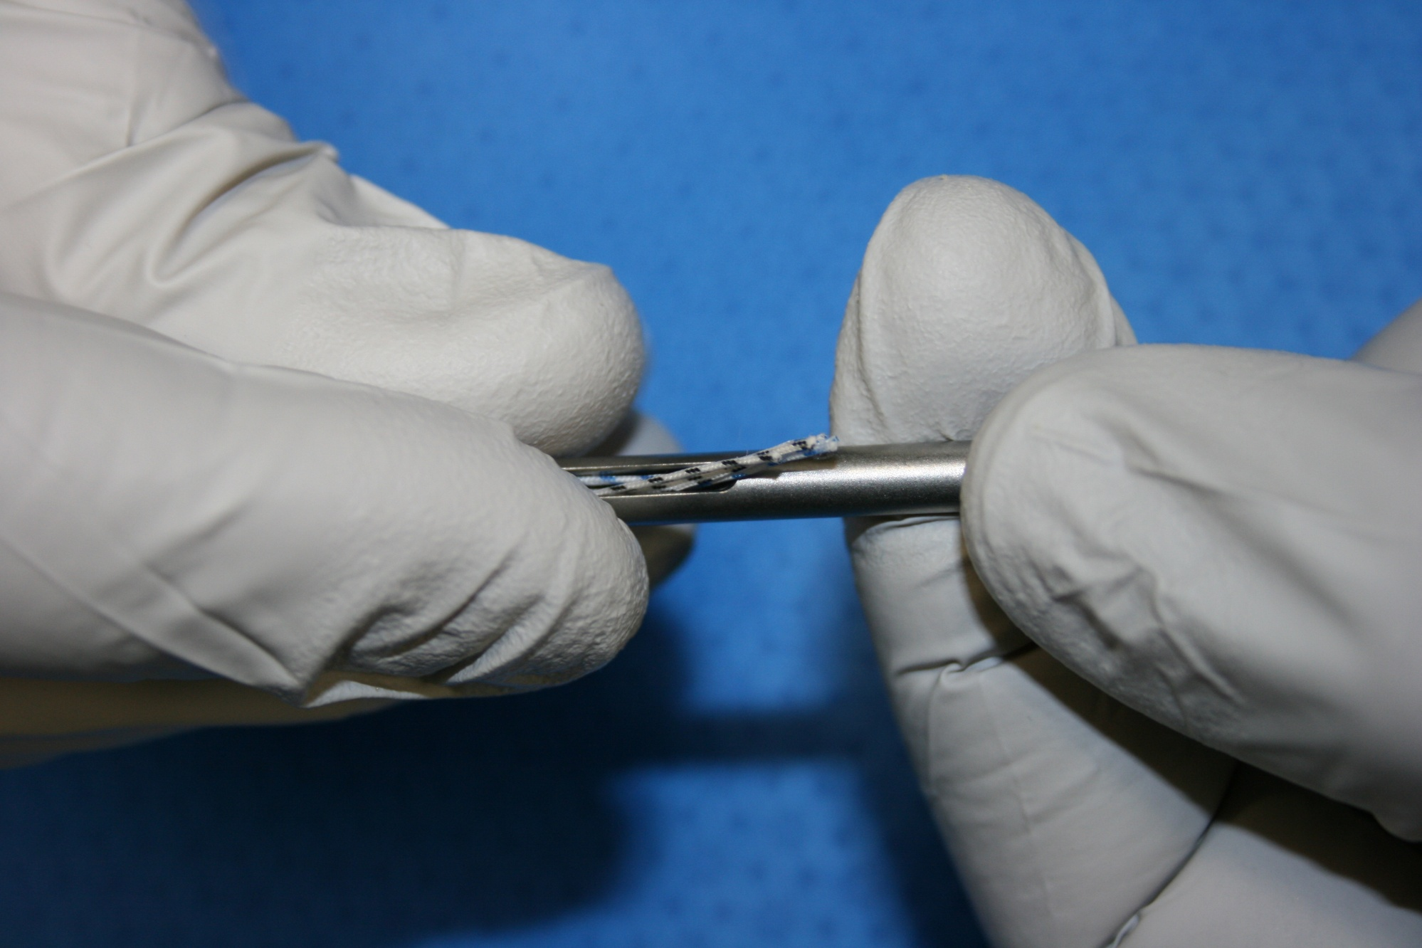
Loading the 5.5mm Cuff Anchor Inserter
5.5mm Cuff Anchor
STEP 2

Slide 4
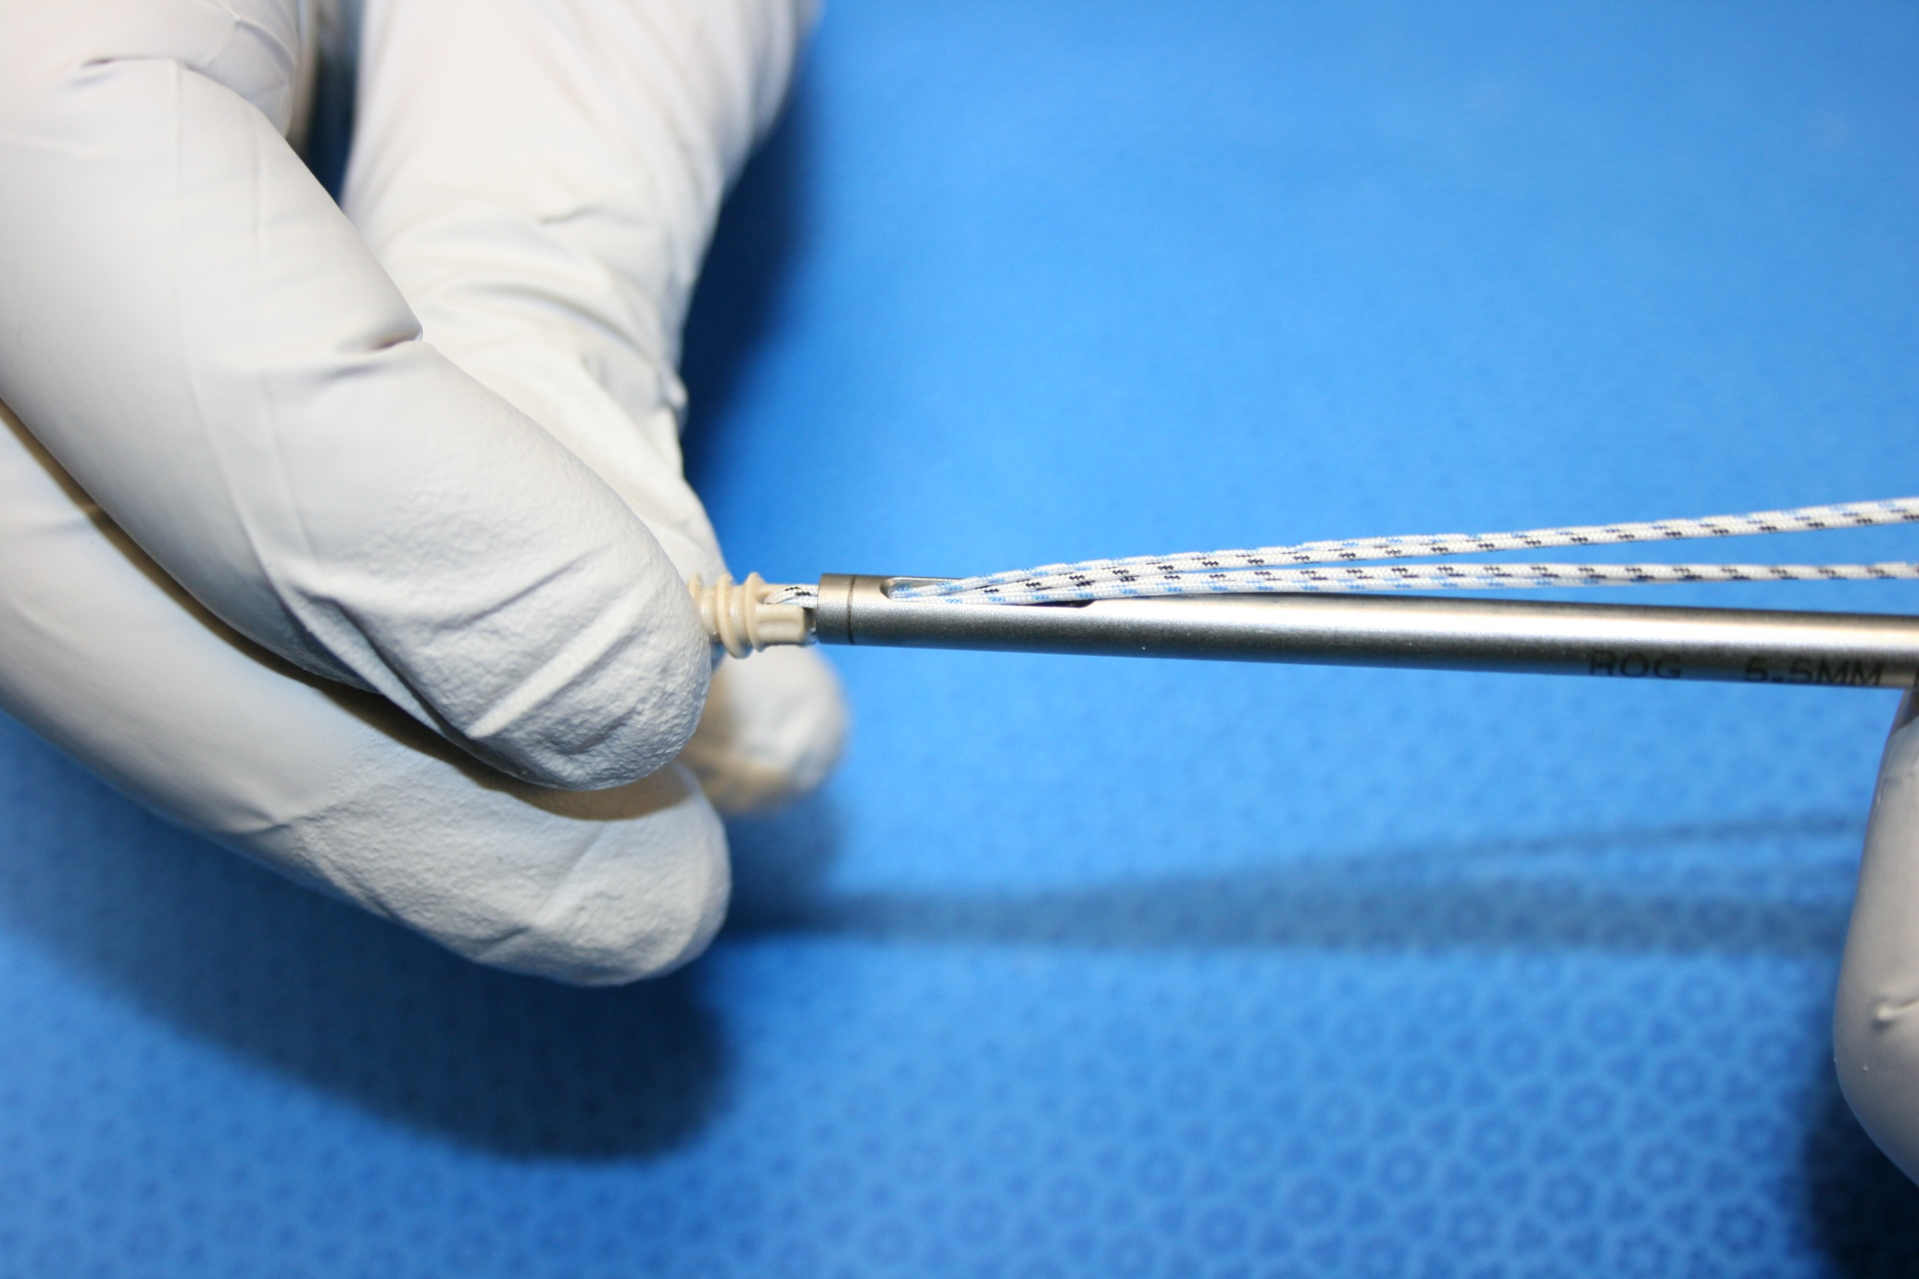
Loading the 5.5mm Cuff Anchor Inserter
5.5mm Cuff Anchor
STEP 3

Slide 5
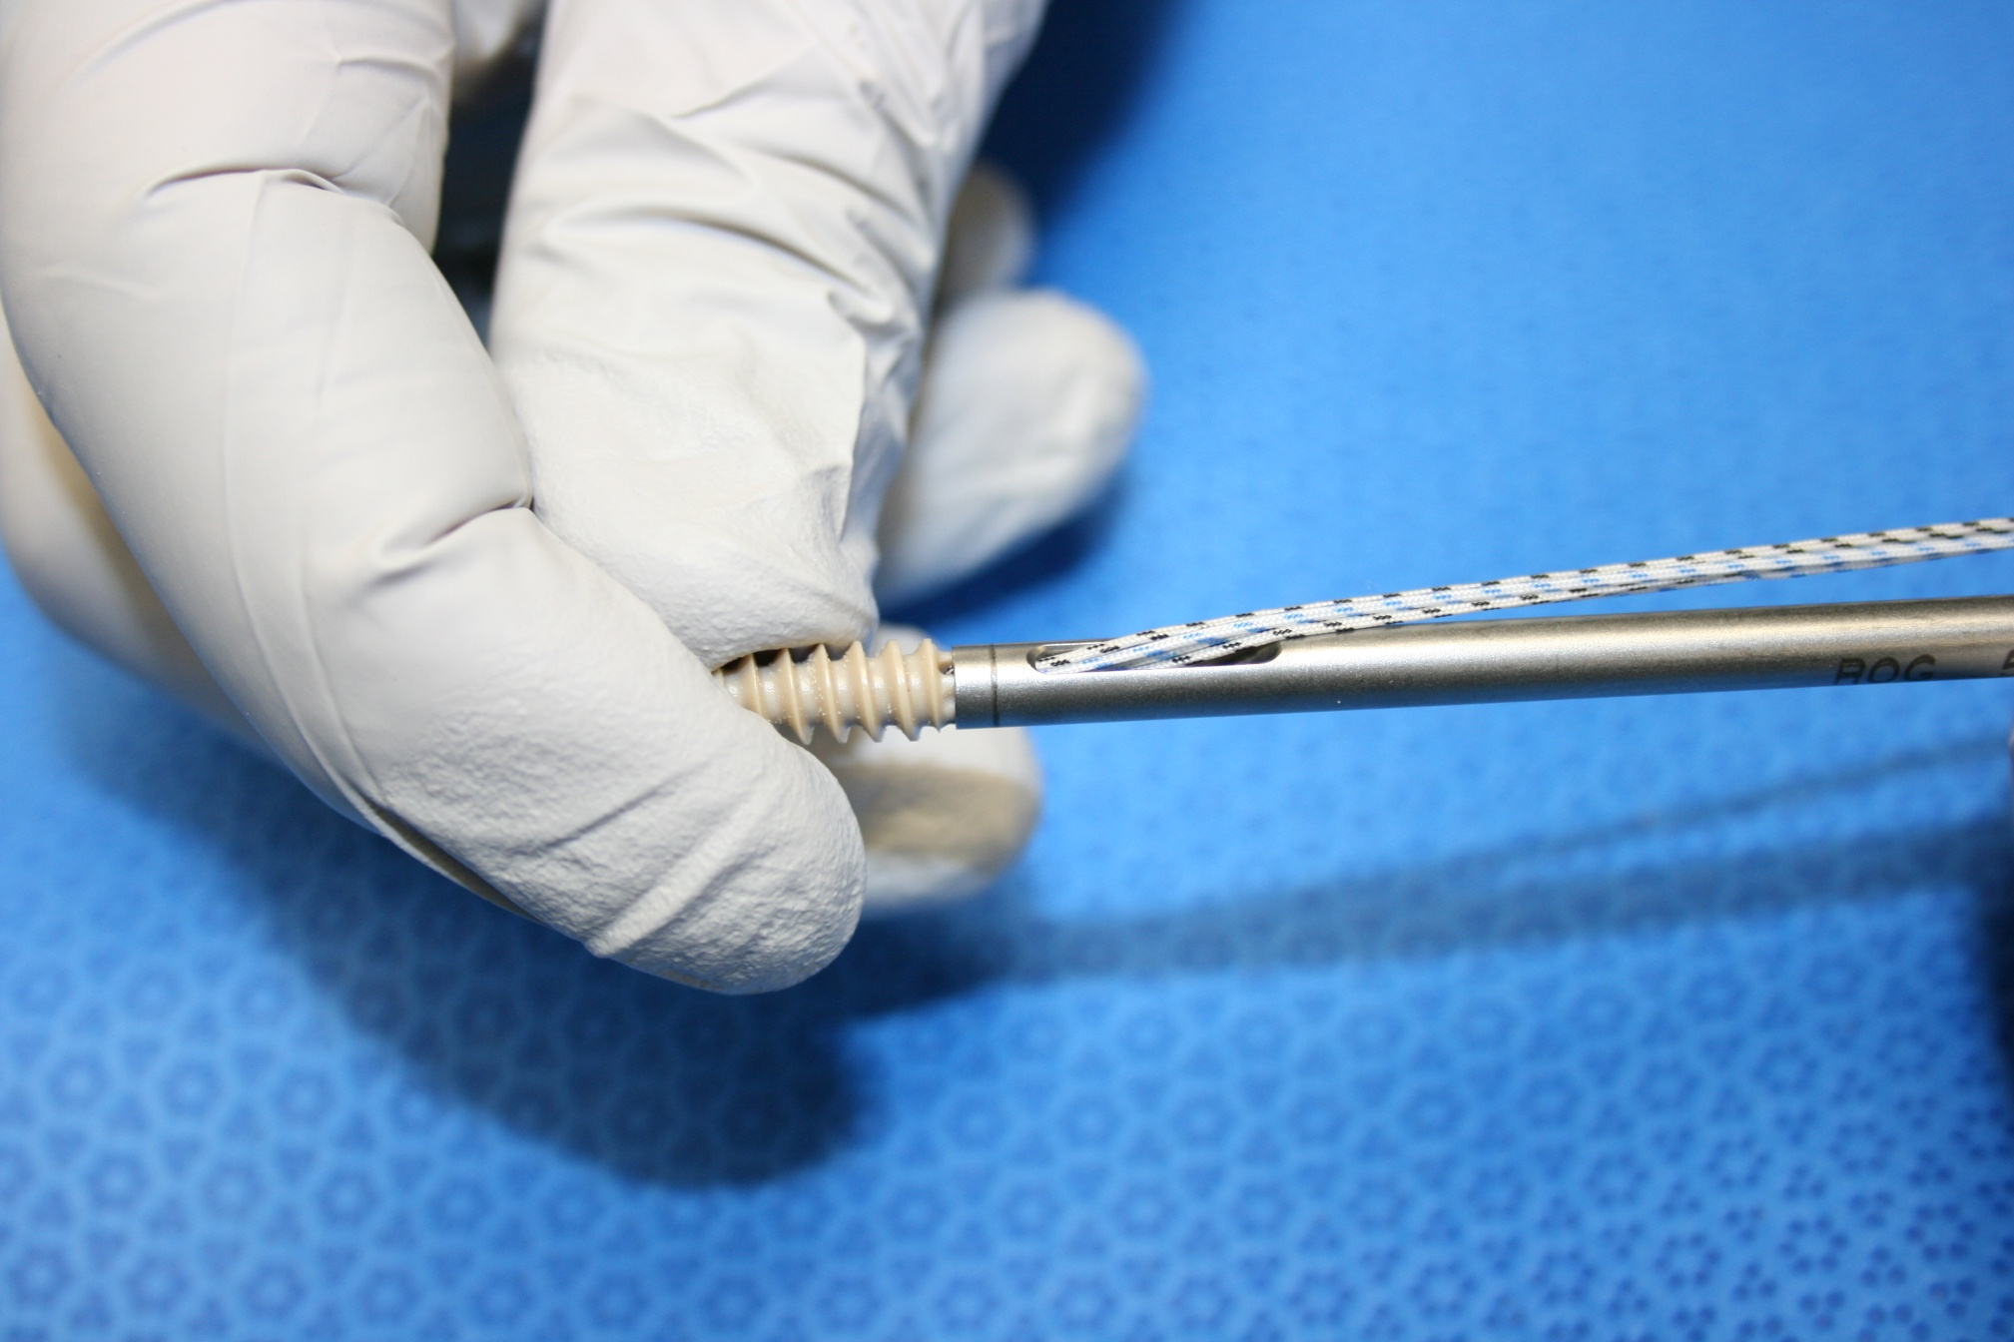
Loading the 5.5mm Cuff Anchor Inserter
5.5mm Cuff Anchor
STEP 4

Slide 6
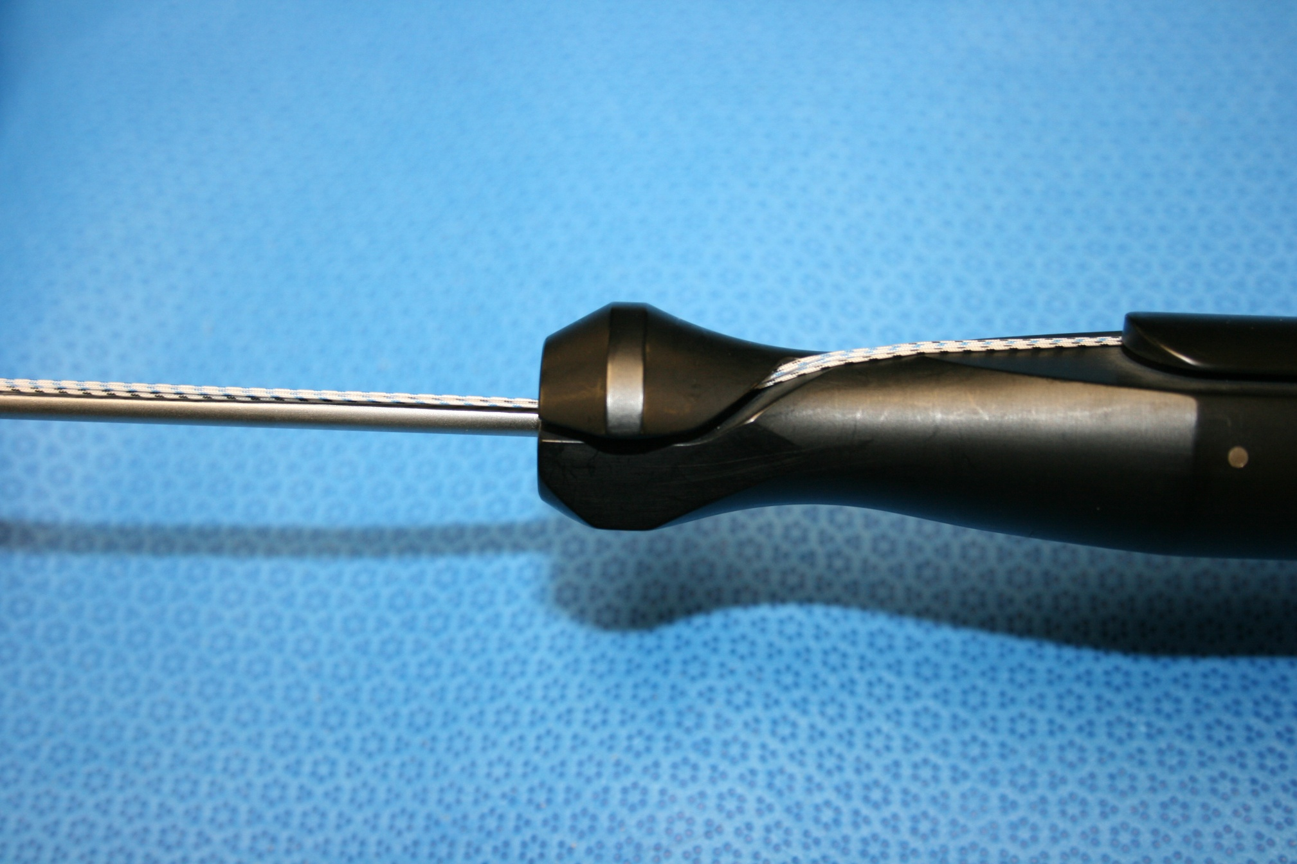
Loading the 5.5mm Cuff Anchor Inserter
5.5mm Cuff Anchor
STEP 5

Slide 7
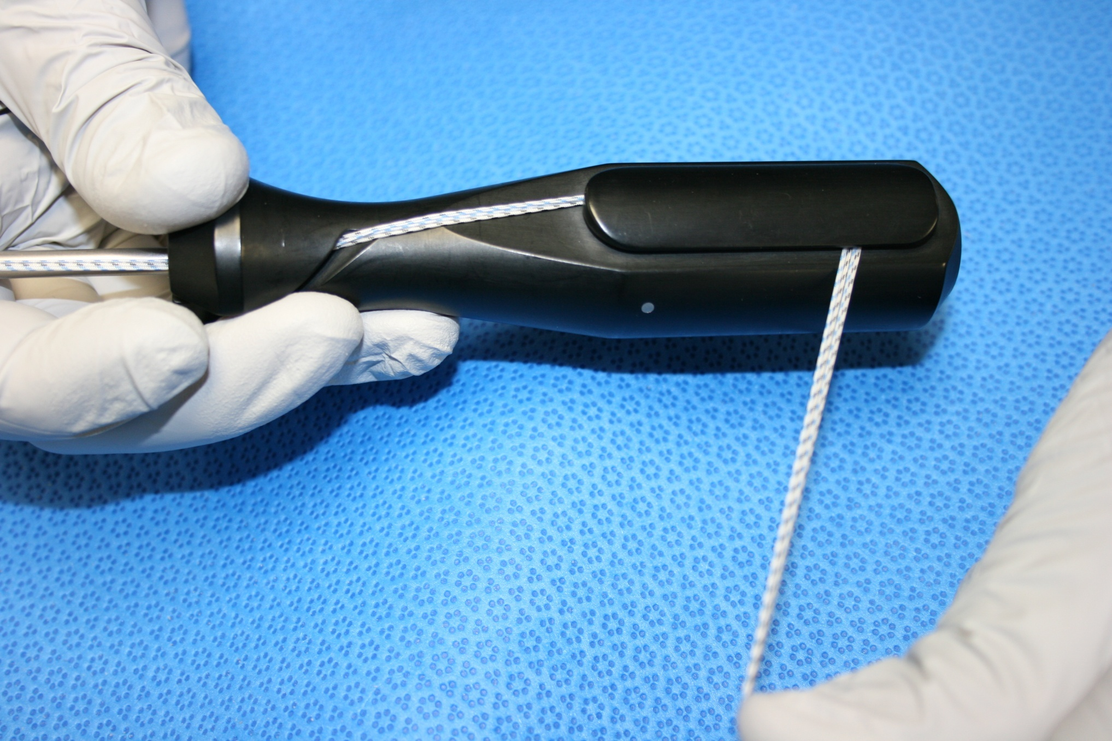
Loading the 5.5mm Cuff Anchor Inserter
5.5mm Cuff Anchor
STEP 6

Slide 8
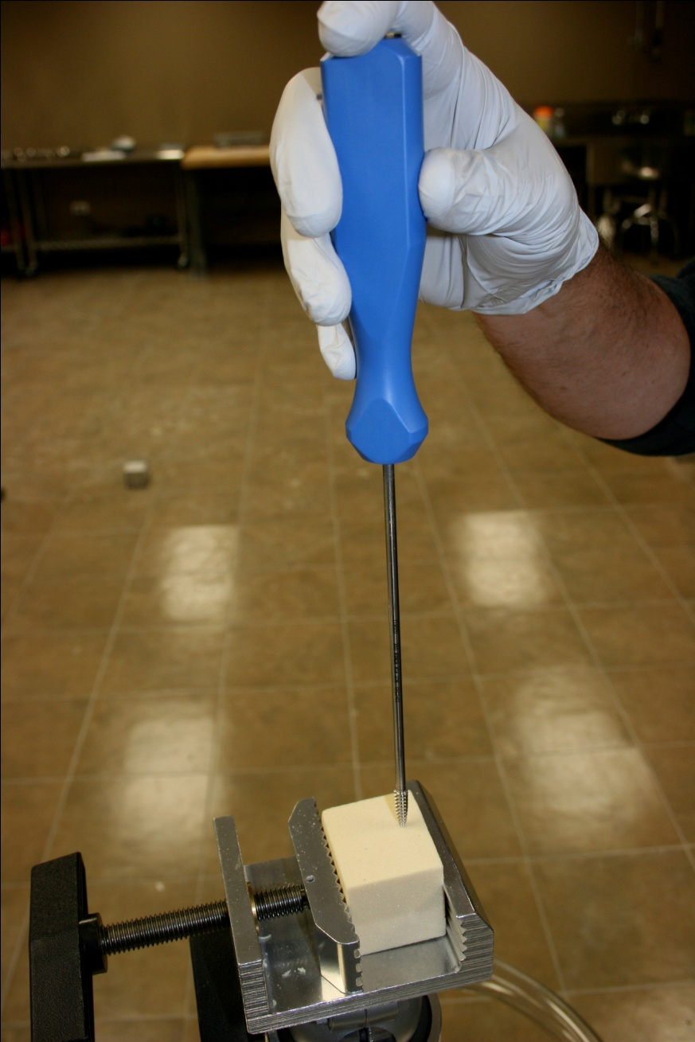
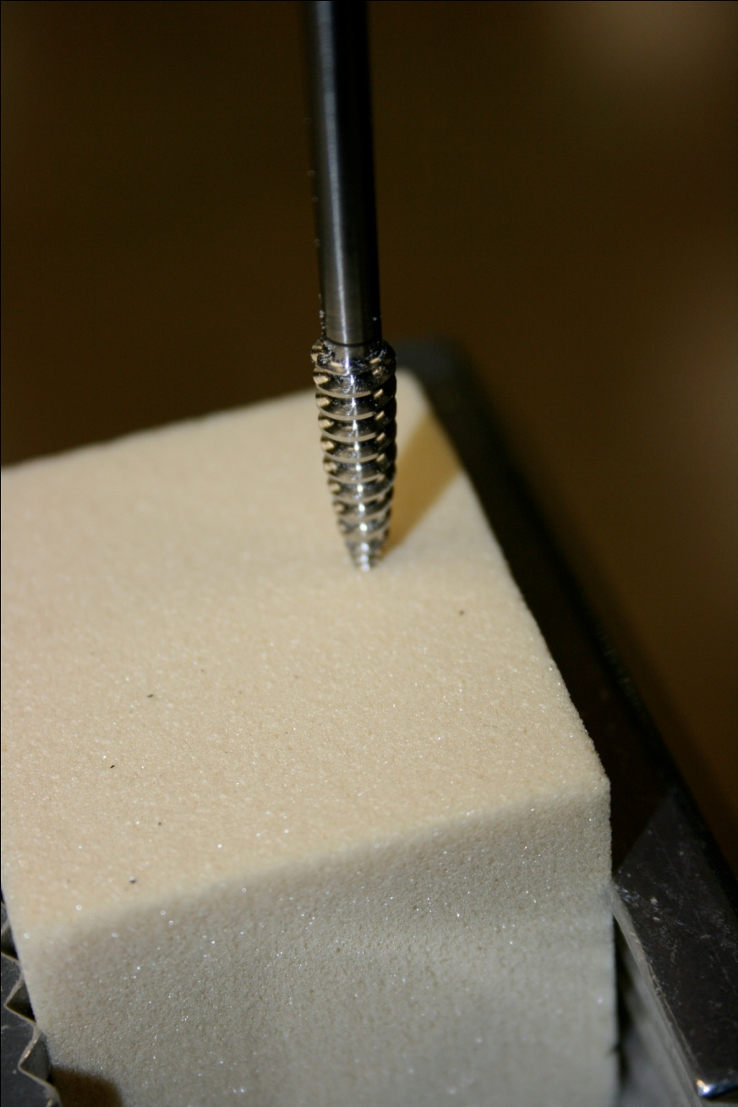
Advance the 5.5mm Tap
5.5mm Cuff Anchor
STEP 7

Slide 9
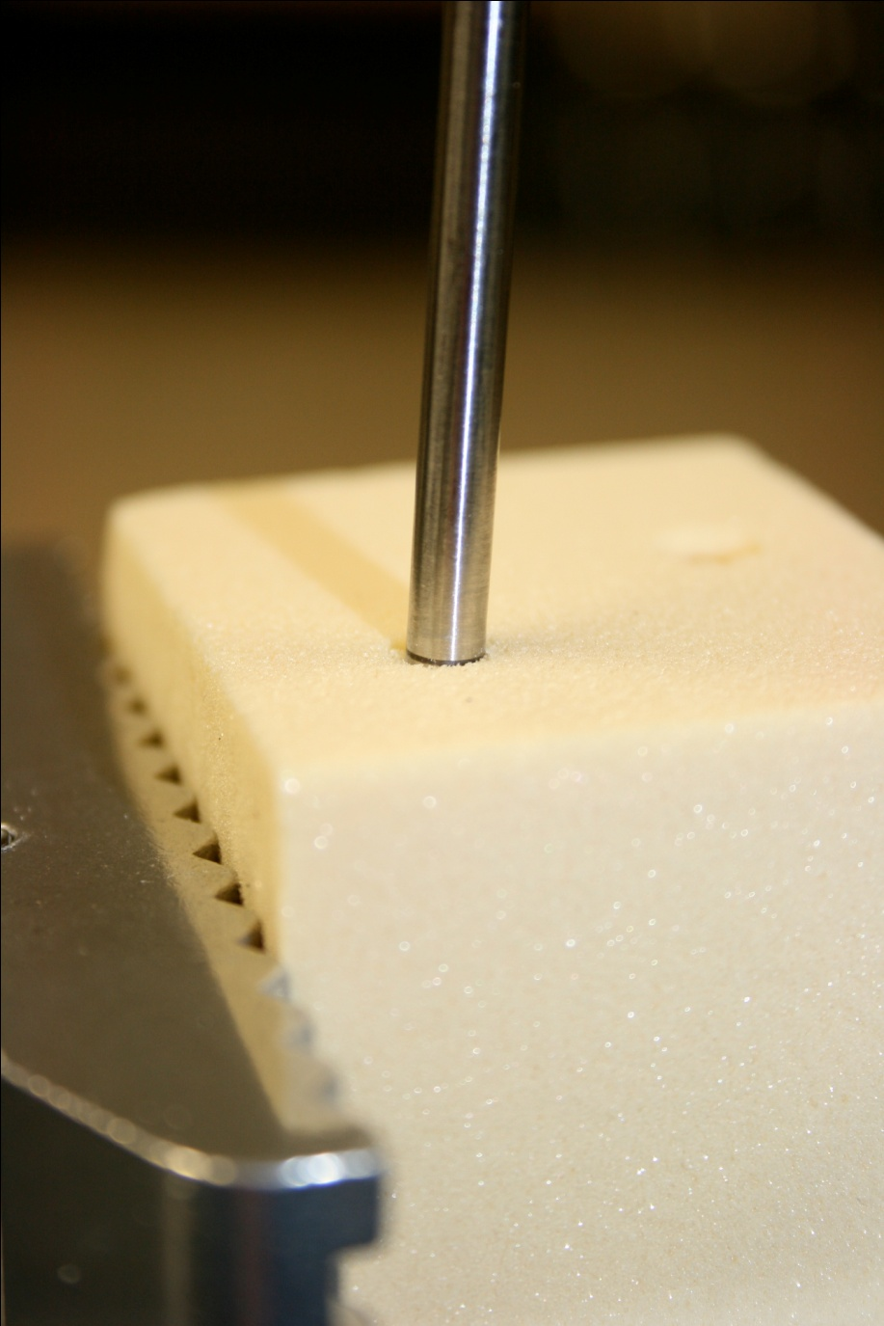
Stop when the Laser Line is at bone
5.5mm Cuff Anchor
STEP 8

Slide 10
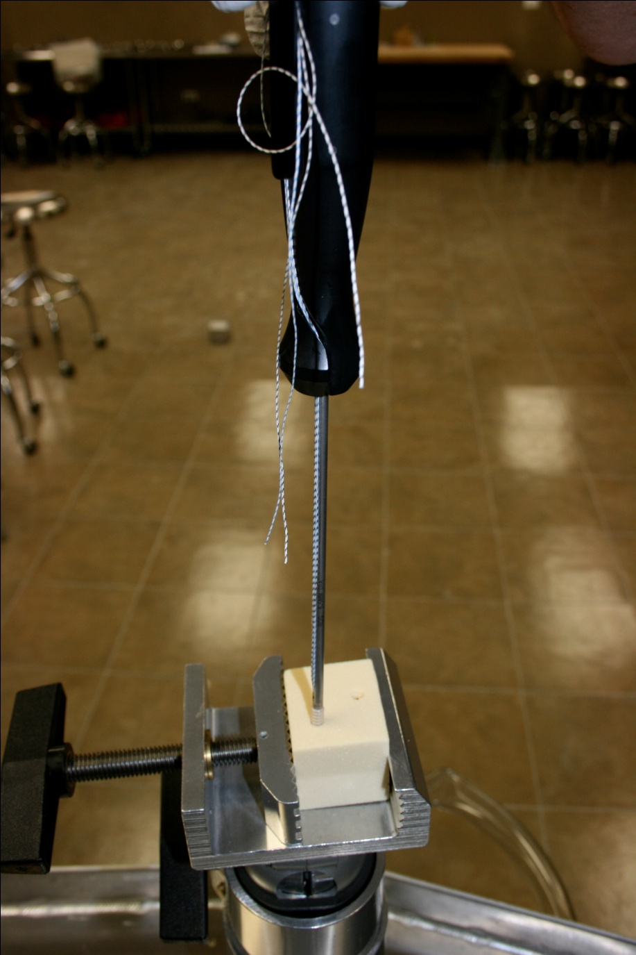
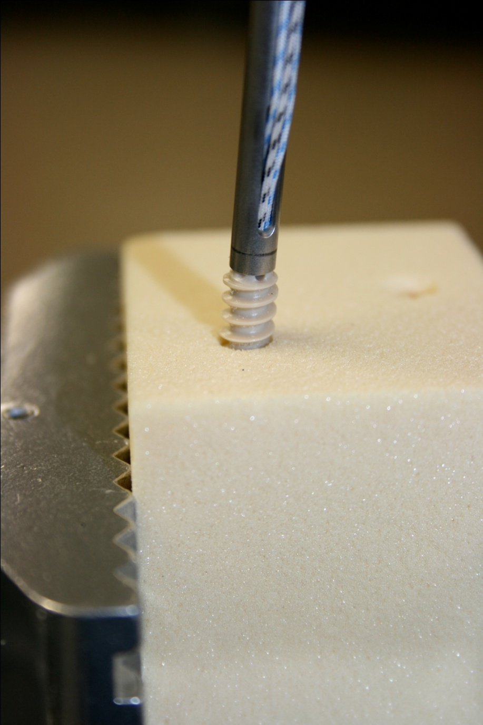
Advance 5.5mm Anchor Inserter
5.5mm Cuff Anchor
STEP 9

Slide 11
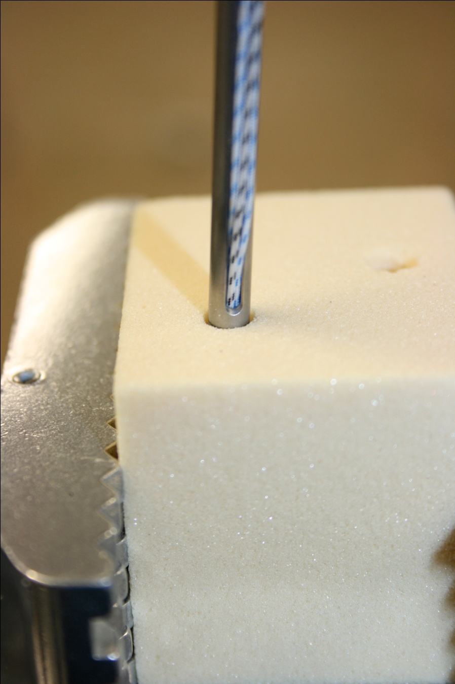
Stop when the Laser Line is at bone
5.5mm Cuff Anchor
STEP 10

Slide 12
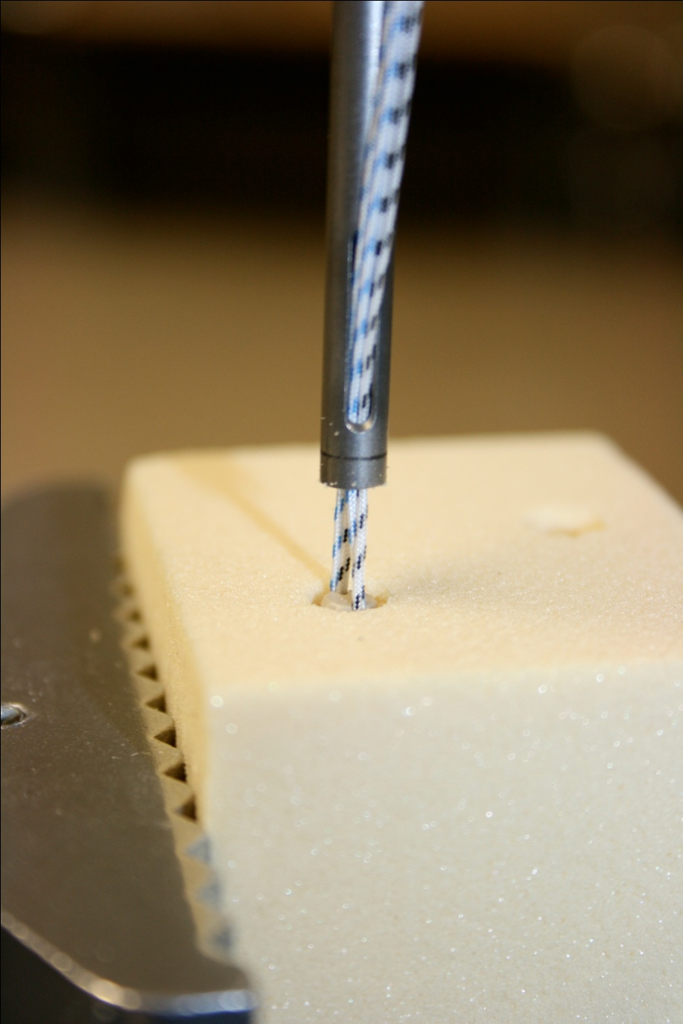
Unload Anchor and Remove 5.5mm Inserter
5.5mm Cuff Anchor
STEP 11

